Slide 1
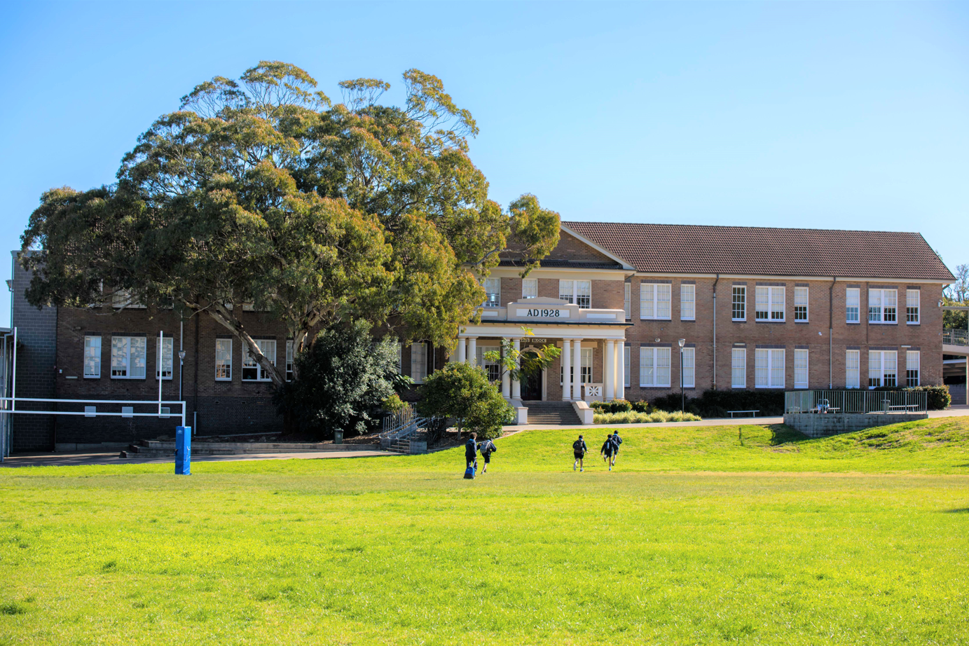
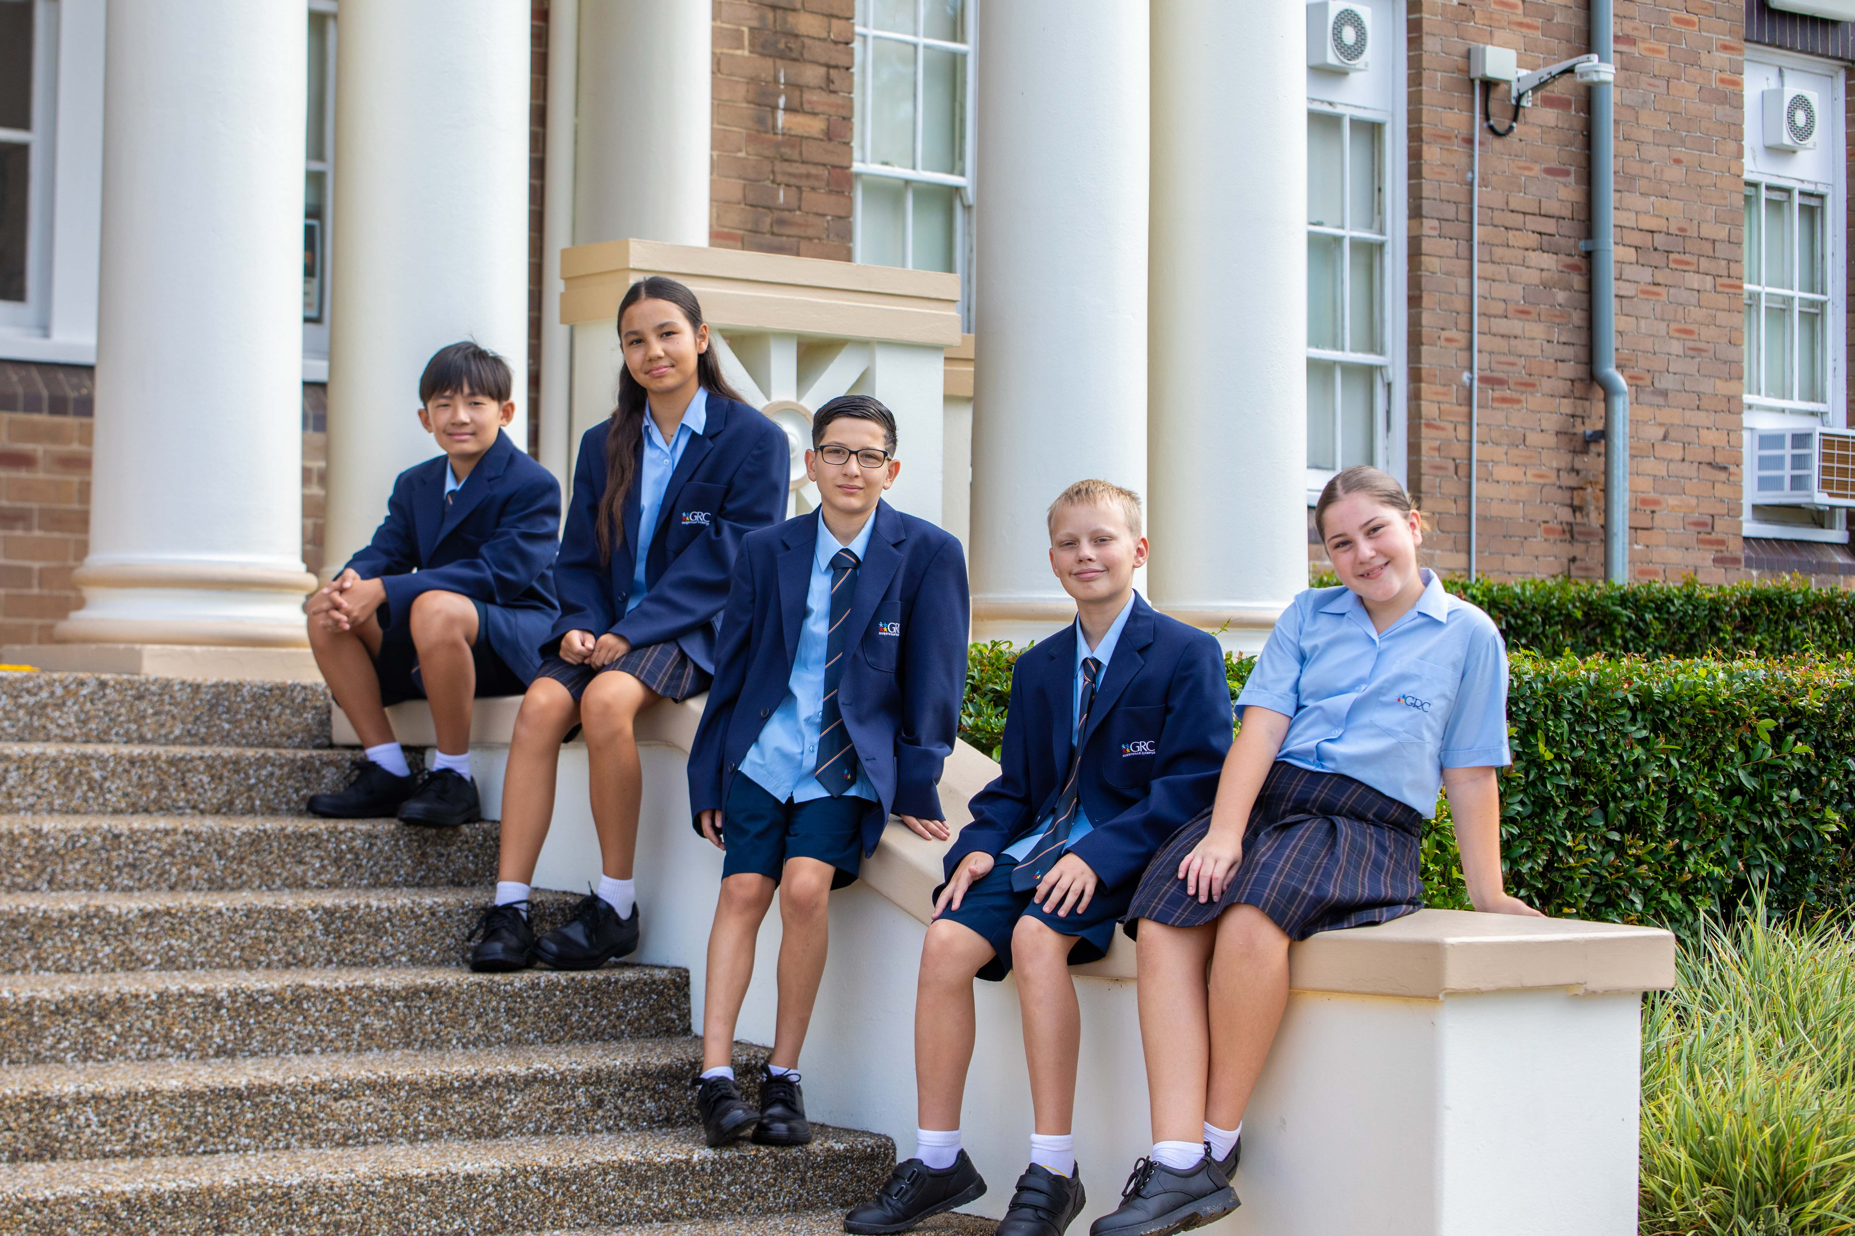
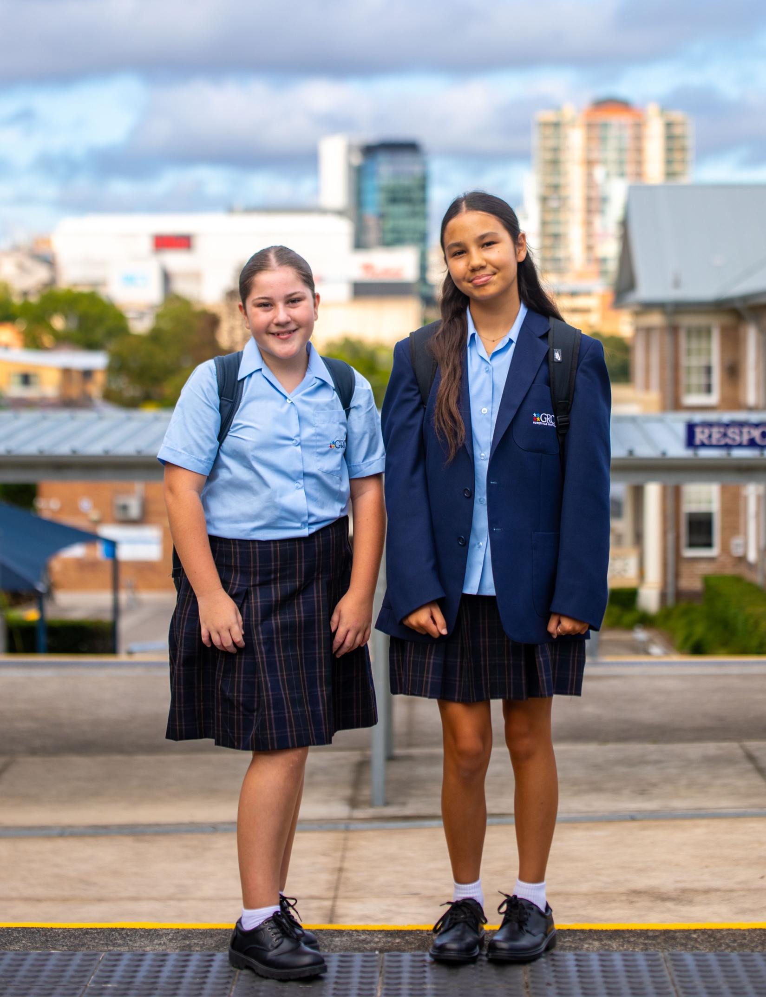
2025 Open Night
Notes:
DD

Slide 2
Acknowledgement of Country
Notes:
DD
Acknowledgement of Country:
We acknowledge the Biddegal People as the Traditional Custodians of the lands on which we meet.
We pay our respects to Aboriginal Elders past, present and emerging, and to all Aboriginal and Torres Strait Islander people present.
We acknowledge their continued spiritual and cultural connection to Country.
As we share knowledge, teaching, learning and research here today, we also pay respect to the knowledge embedded forever within the Aboriginal Custodianship of Country.
We must always remember that this land, beneath the carpet and concrete, was and always will be Aboriginal land.

Slide 3
OVERVIEW
01
School vision
statement
05
Teaching and Learning
09
Leadership Opportunities
02
06
Literacy and numeracy
10
College Programs
Staff
03
07
Positive Behaviour for Learning
11
Parent Engagement
College structure
04
Coeducational Setting
08
Wellbeing Programs
12
Oatley Senior Campus
Notes:
DD

Slide 4
Georges River College (GRC), Hurstville Campus educates young students to become confident and creative individuals who are self-motivated learners, with the skills for future success.
As a 7-10 middle school we create a nurturing, inclusive environment that promotes students to strive for their best and celebrate their success.
Our vision statement
Notes:
KK

Slide 5
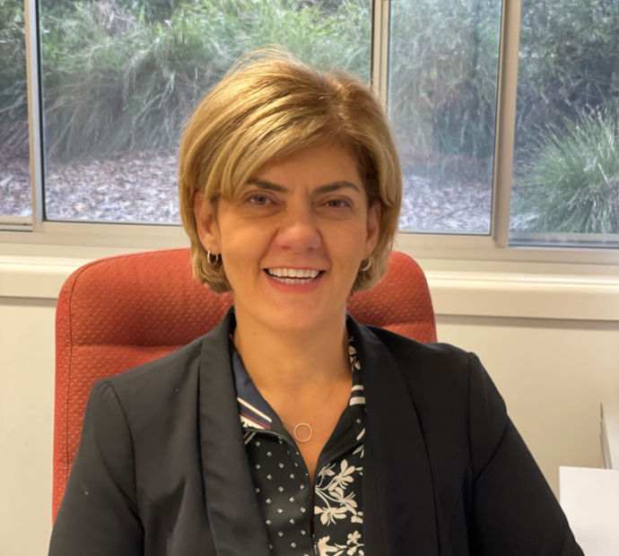
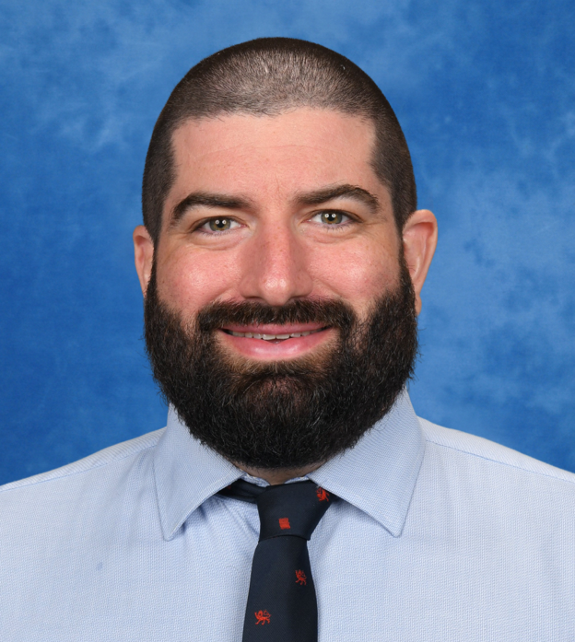
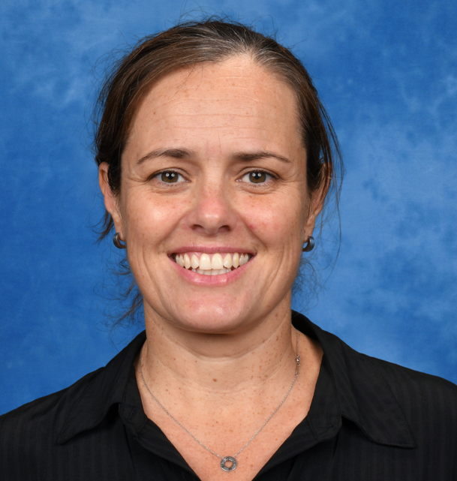
Our Staff
Kathy Klados
Principal
David Davis
Deputy Principal
Student Wellbeing
Rachelle Pirie
Deputy Principal
Teaching and Learning
Notes:
KK – Also mention Anna Tsoutsa and Anna Girginis

Slide 6
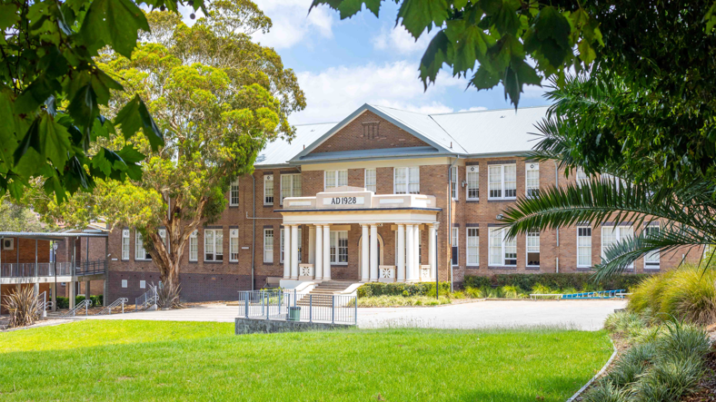
Hurstville Campus Principal
Kathy Klados

Slide 7
Oatley Senior Campus​
Peakhurst
Campus​
Hurstville
Campus​
Penshurst Campus​
Georges River College Structure
Notes:
KK

Slide 8
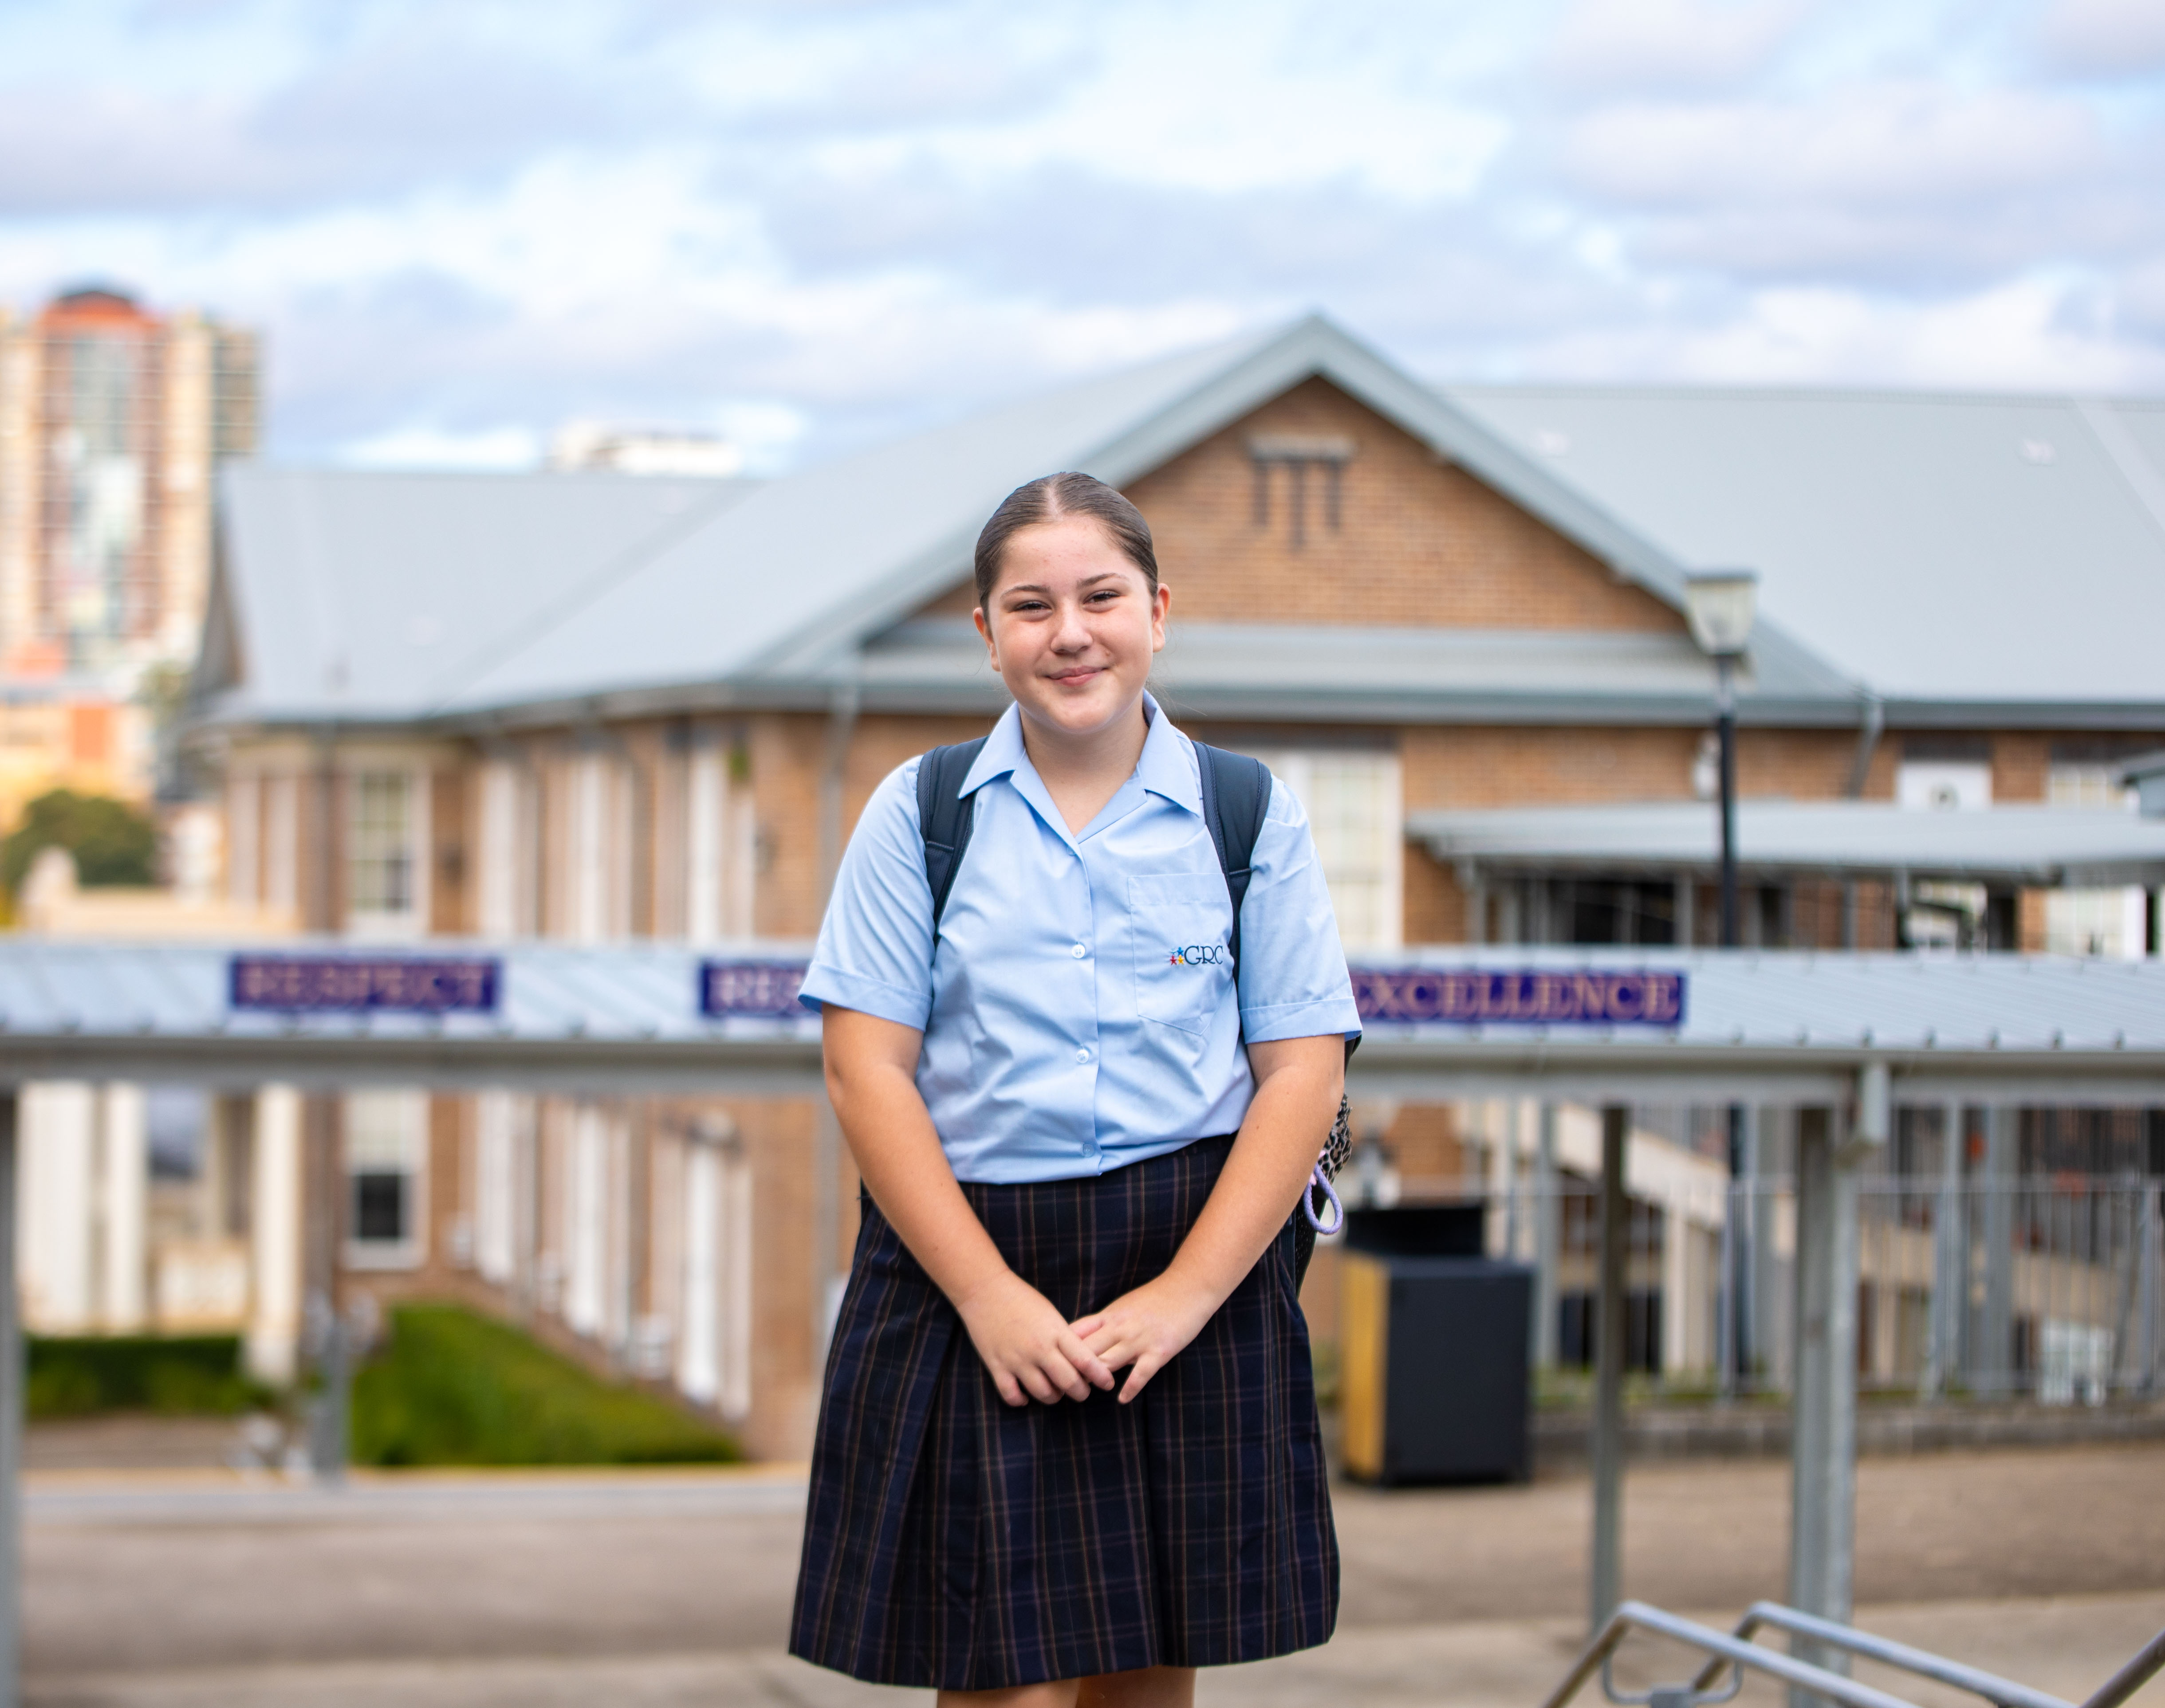
Georges River Hurstville Campus is a coeducational setting, starting from Year 7 and 8 in 2025, and Year 9 and 10 from 2026.
Georges River College Oatley Senior Campus remains the same, enrolling both boys and girls for Years 11 and 12
Coeducational Setting

Slide 9
Primary School Boundaries 2025
Feeder Primary Schools
Primary schools that feed into GRC HBC:
Hurstville Public School
Carlton Public School
Bexley Public School
Hurstville South Public School
Access School Finder for your 2026 enrolment.

Slide 10
Supporting girls at Hurstville Campus
DoE Procedures
Student Education
NESA requirements
Upgrade in facilities/ infrastructure
Staff Training
Designated Support Staff
Extra Curricula activities
Notes:
DOE Procedures
NESA requirements
Subject selection – student choice
Curriculum reform
Extra Curricula Activities
Leadership
debating
Facilities and infrastructure upgrade
Designated Year 7 area
Large school campus can accommodate 1000 students
Staff Training
100 % taught boys and girls
Designated support staff
Female adviser
Student Education
PBL – respect, responsibility aiming for excellence

Slide 11
Why GRC Hurstville Campus?
Leadership
Results
Well-being Programs
Curriculum Programs
Specialised stage 4/5 & 6 settings
Smaller school with individualized support
Opportunities beyond
Confidence in the College structure
Confidence in the GRC Oatley

Slide 12
Hurstville Campus Deputy Principal
Rachelle Pirie

Slide 13
Teaching and Learning
TAS
Visual Arts
PDHPE
Science
Music
English
Languages
Mathematics
Sport
HSIE (History & Geography)
Notes:
RP Teaching and Learning – across Yr 7-10
English
Mathematics
HSIE (History & Geography)
Science
PDHPE
TAS
Visual Arts
Music
Languages
Sport

Slide 14
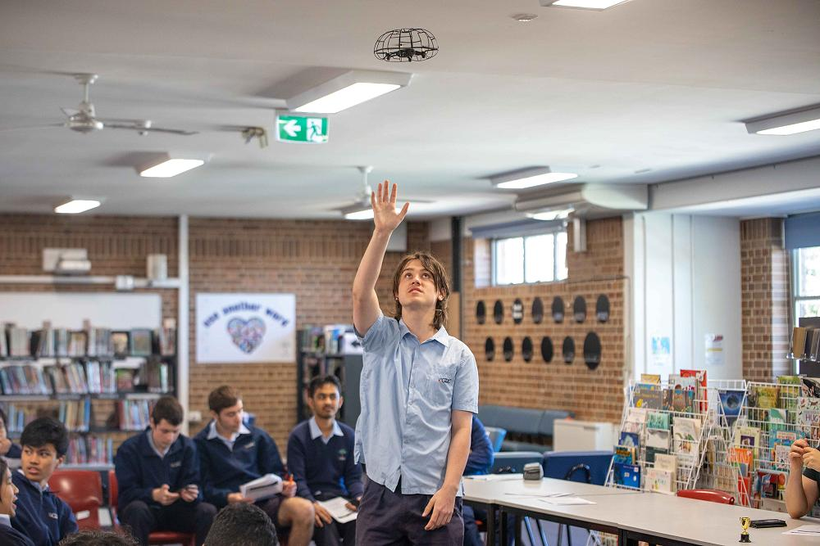
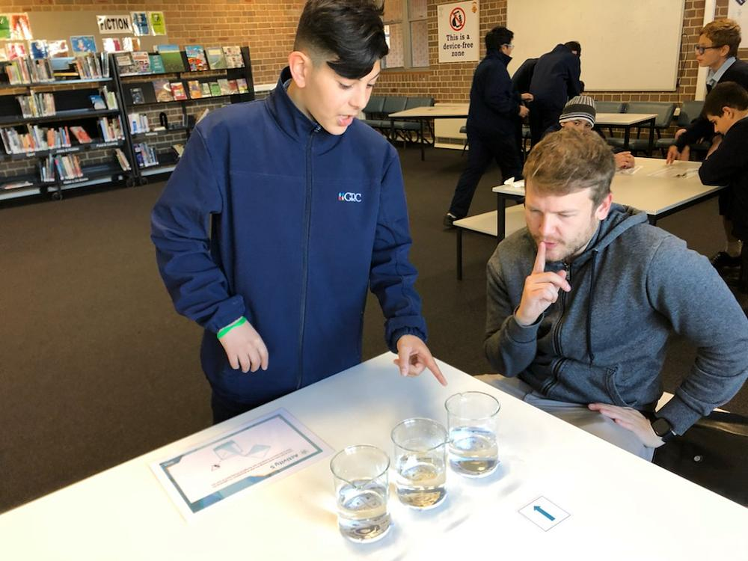
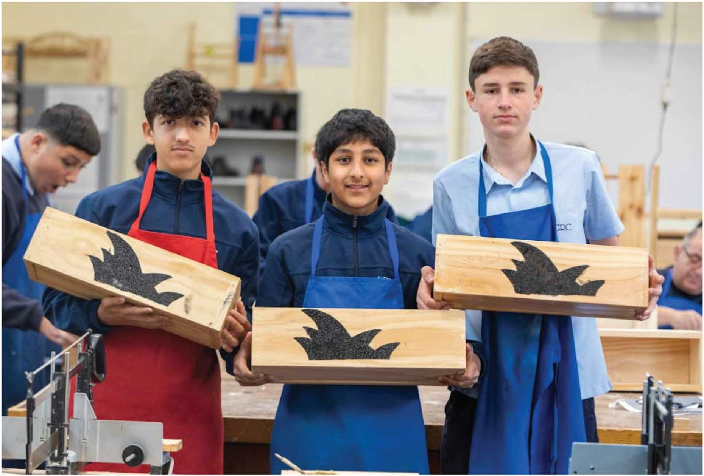
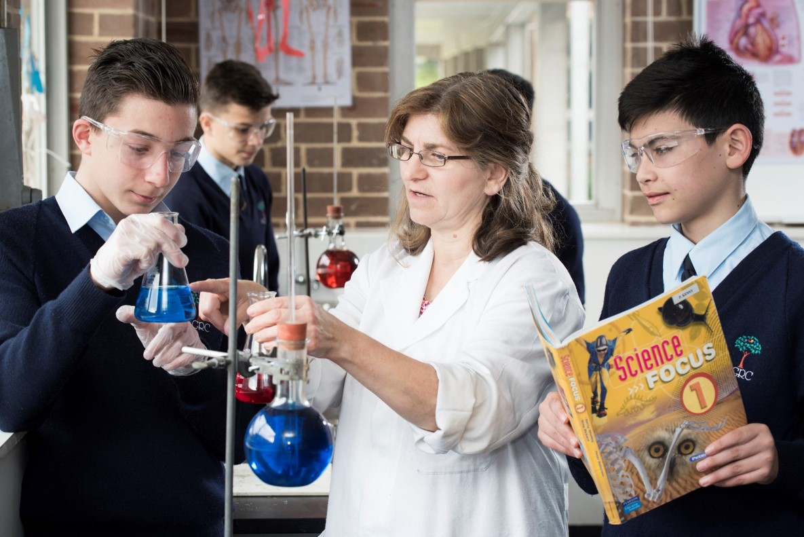
Teaching and Learning
Notes:
RP Focused on delivering a high quality, inclusive and holistic education to meet the needs of all students and strives for excellence in teaching and learning.
Opportunities for:
HPGE across all domains Students with additional learning needs (high level of support) – EAL/D, learning difficulties, short term assistance due to illness
Extra curricular activities that further promote opportunity and excellence – rock band, knockout sport, incursions and excursions
Aboriginal and Torres Strait Islander students – build connection to country and promote cultural awareness amongst all

Slide 15
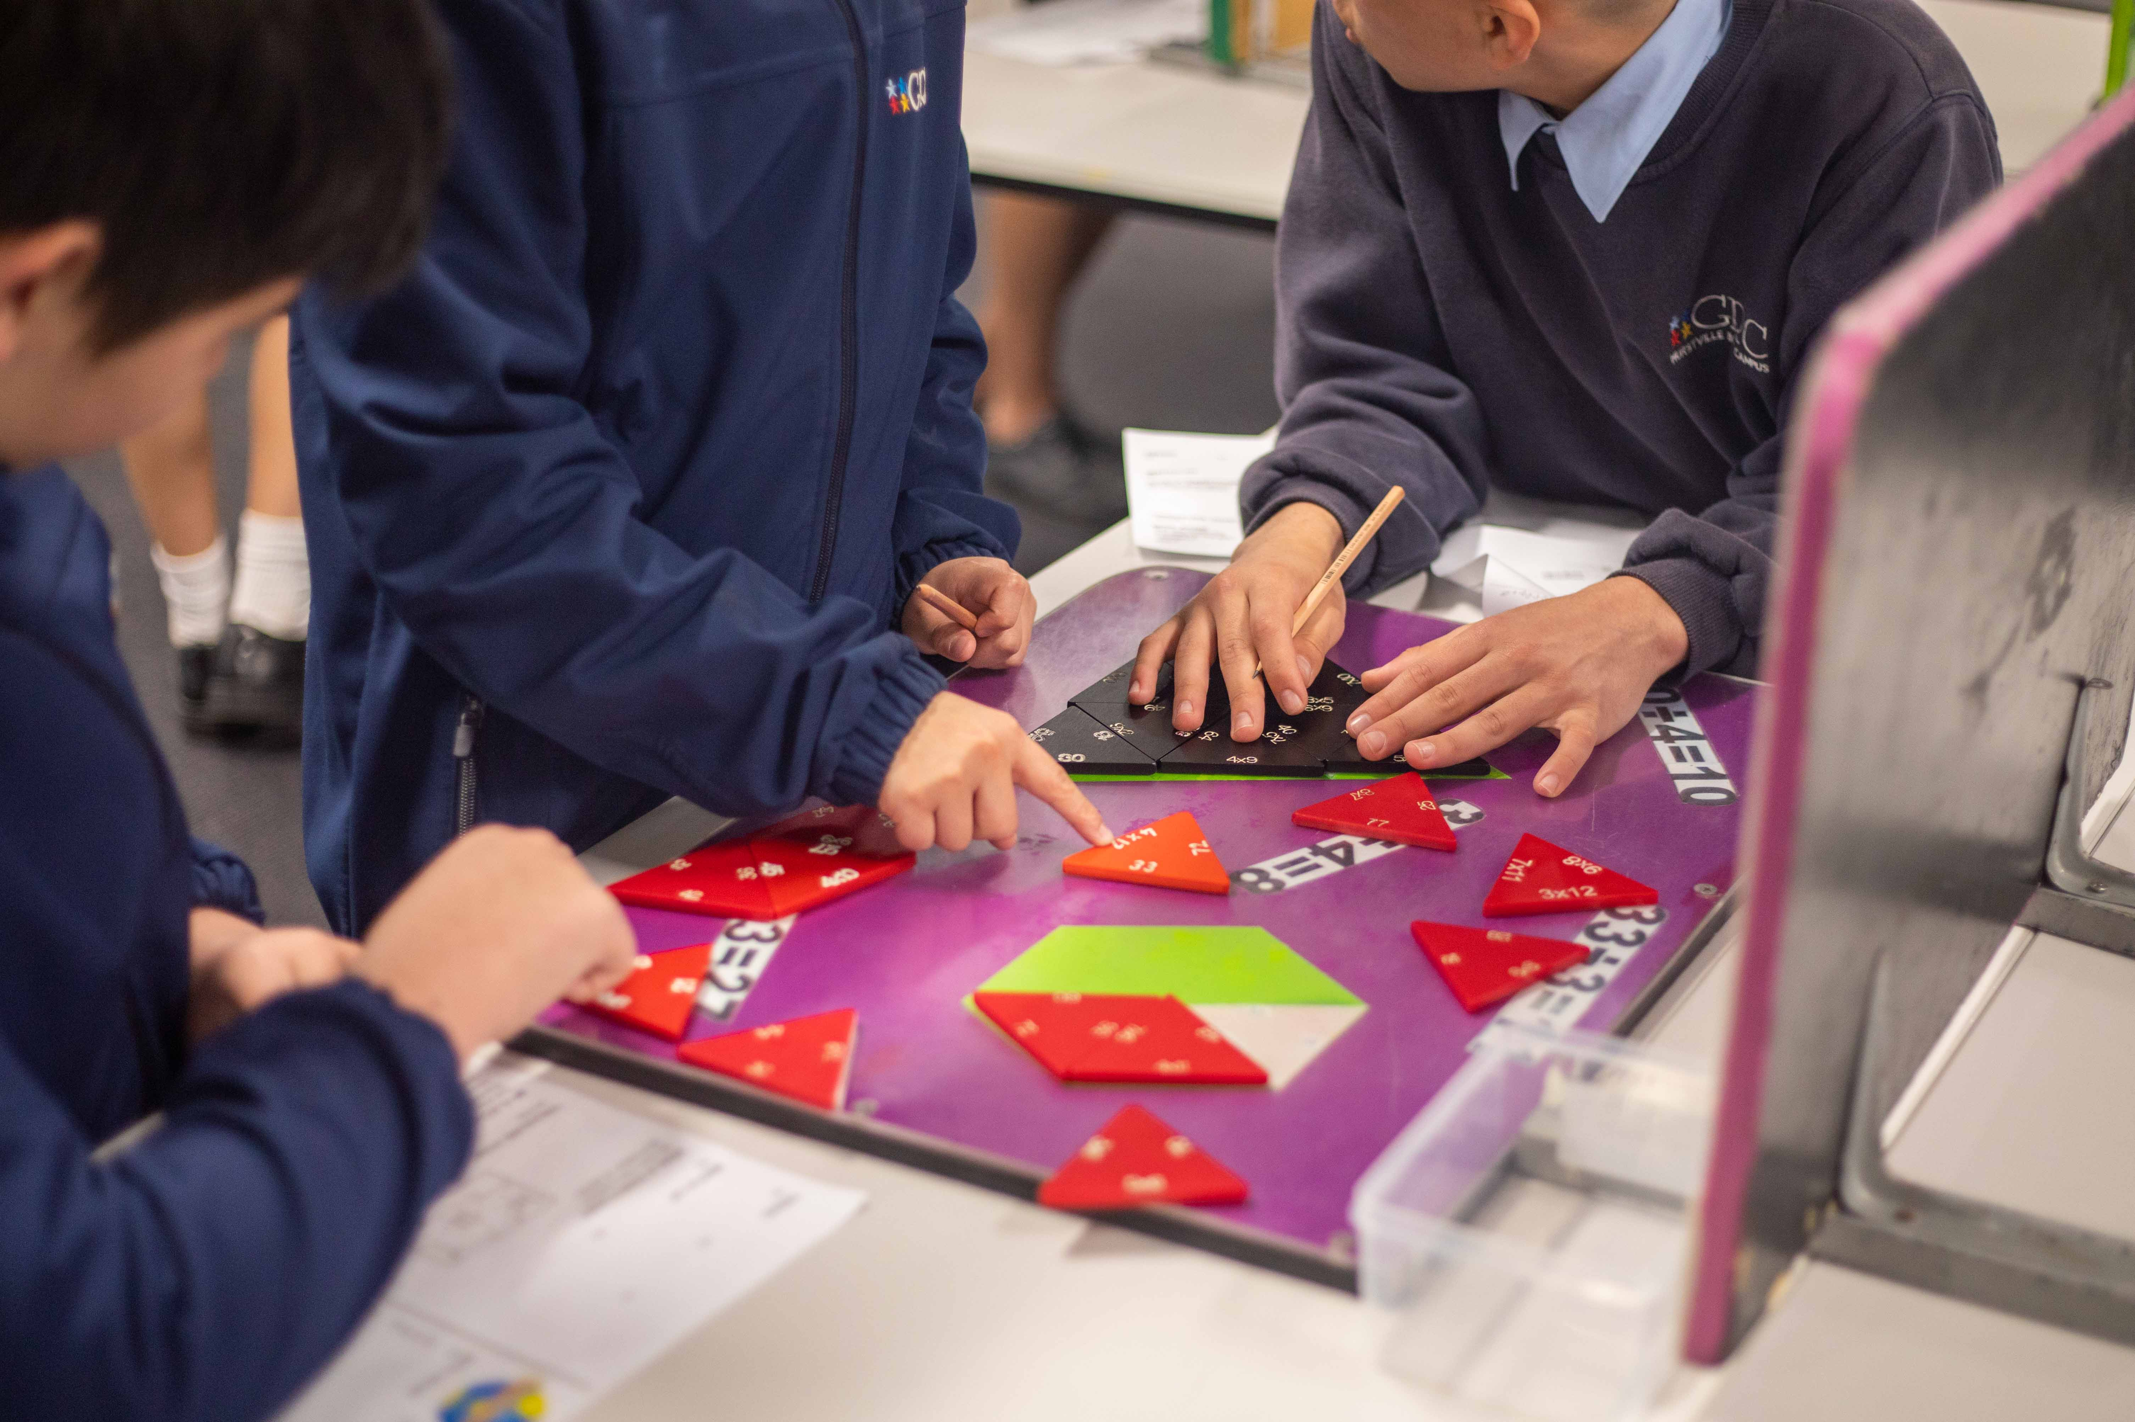
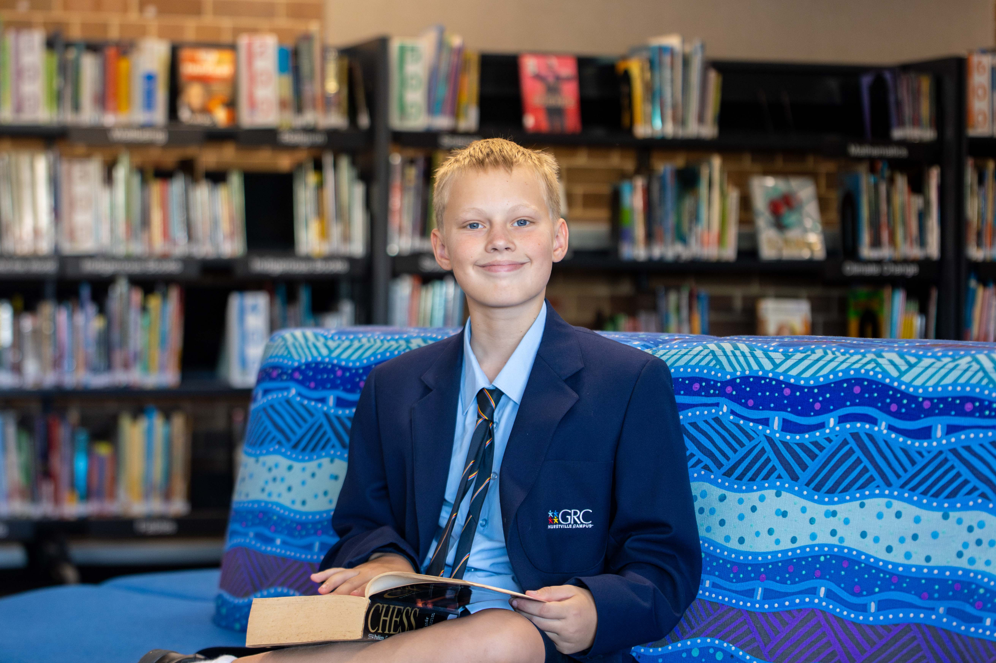
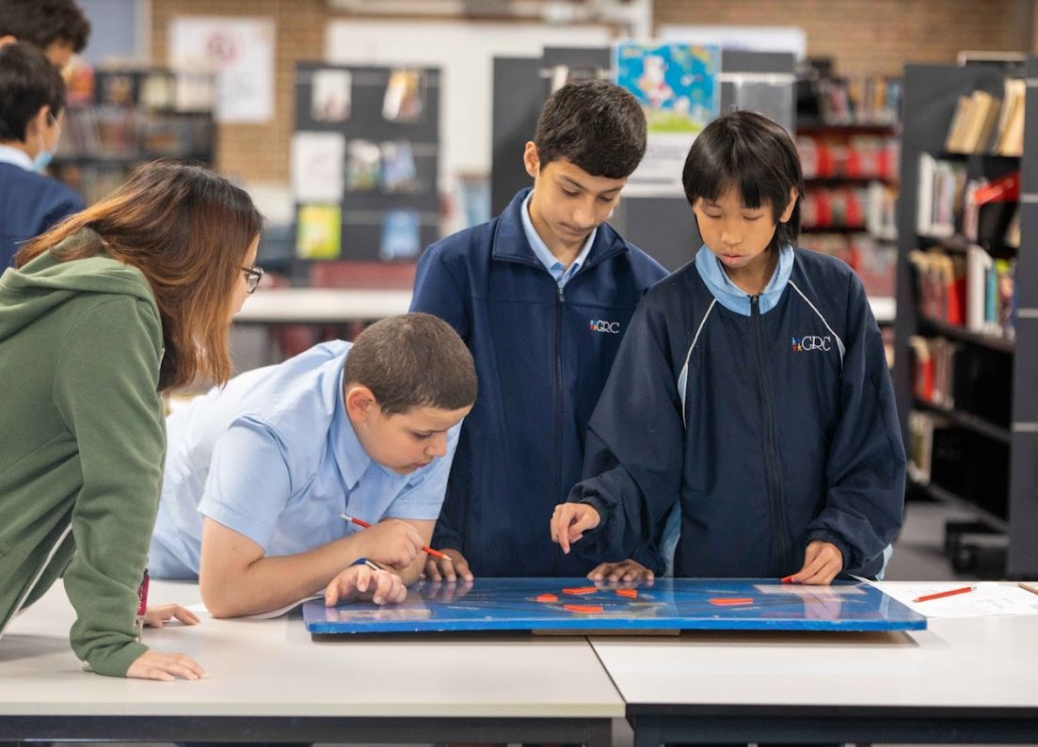
Literacy and Numeracy
Notes:
RP Literacy and Numeracy – key to success in all subjects and is a whole school priority
Reading Renaissance Program
Education Perfect
Macq lit
HELP
COVID ILSP
NAPLAN
College programs:
Numbers for Learning Numbers for Life
Reading for Meaning, Writing for Purpose

Slide 16
Every Number and Every Word Counts
literacy
Individual – intensive support for students with additional needs
Targeted – timetabled classes for focus areas of numeracy/reading (years 7 and 8)
Whole school – consistent approach to literacy and numeracy in all subjects
Individual
Targeted
Whole school
Notes:
RP
Literacy and Numeracy – key to success in all subjects and is a whole school priority
Reading Renaissance Program
Education Perfect
Macq lit
HELP
Reading for Meaning, Writing for Purpose
Numbers for Learning Numbers for Life
NAPLAN, Best Start, Check in, ICAS
Provide reporting to parents that encompass academic, commitment to learning, and extra curricular activities.
Literacy - The average growth of Year 7 and Year 8 students in reading age is 1.5 years.
Numeracy- Maths Pathway data Year 7 2024 averaged growth of 162% (if 100% is one year’s growth)

Slide 17
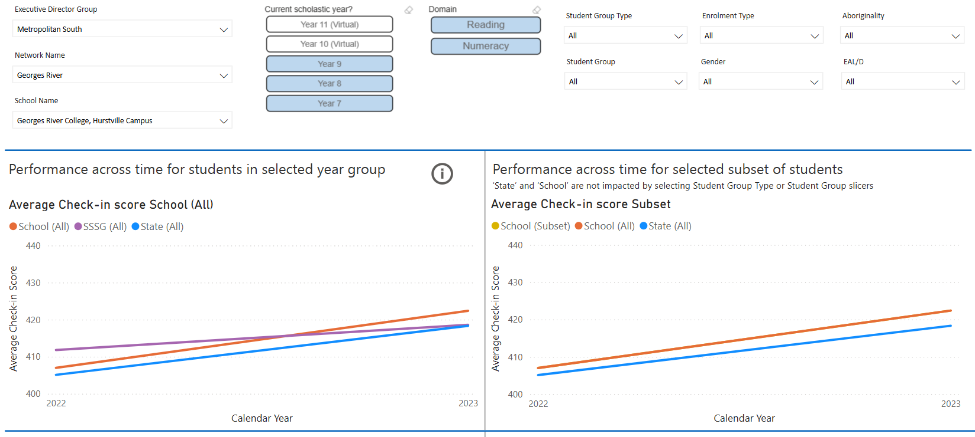
Student Growth & Attainment
Check-in Assessment

Slide 18
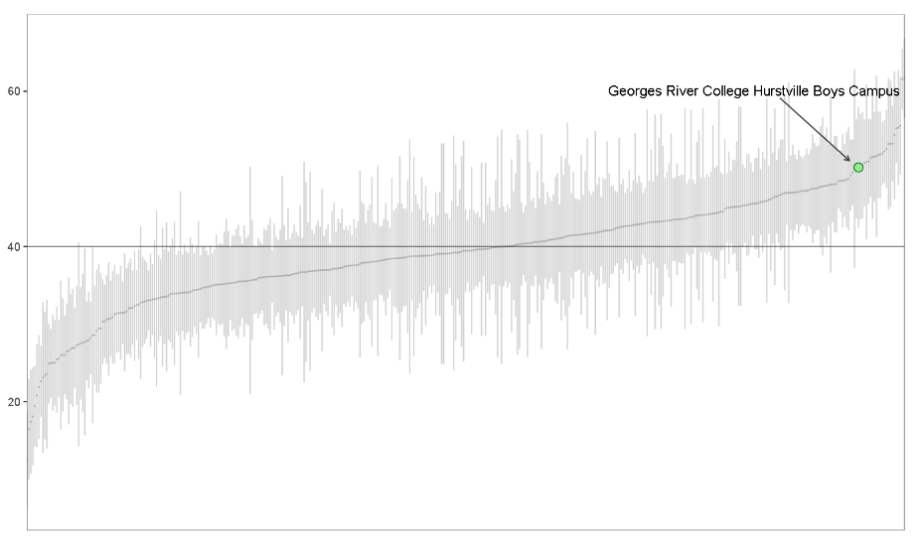
Student Growth & Attainment
NAPLAN
2023
Value Added Across Schools
Displays the growth of student scores across schools in the state between each pair of years
Black line – state average Value-Add

Slide 19
Student Growth & Attainment
NAPLAN
2024
Value Added Across Schools
Displays the growth of student scores across schools in the state between each pair of years
Black line – state average Value-Add

Slide 20
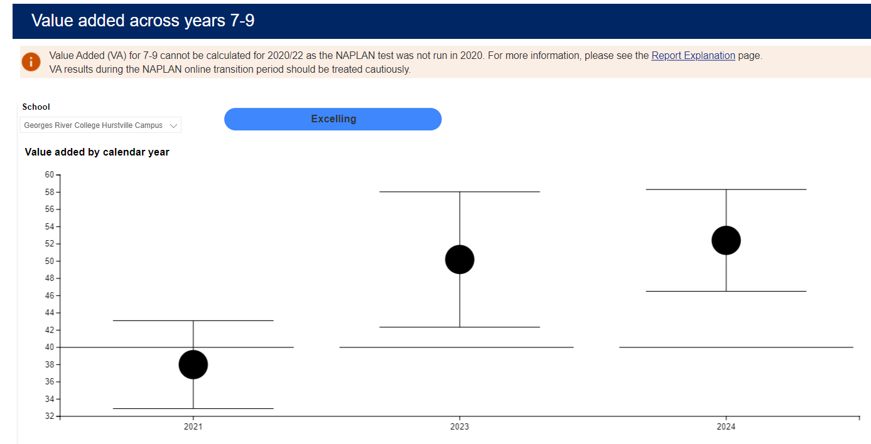
Value Added Across Years – 2024 - Excelling
Average value-added GRC HC
Student Growth & Attainment
Average value-added ALL schools
2021
2023
2024
NAPLAN
Notes:
In the VA Across Years reports, the black dot represents the average value added for that school in that year. The whiskers represent the range of confidence in the value-added estimate for the school, and we are 95% confident that the true value added by the school is within that range. The horizontal line represents the average value added for all schools in the state.

Slide 21
The school offers a range of opportunities to support and extend HPGE students. The programs we run include:
Enrichment class (application required)
Creative writing workshops
Debating
Poetry competition
ICAS assessments
Solar car challenge
School ensemble
Game Changer
High Potential and Gifted (HPGE) Students
Notes:
RP At GRC Hurstville Campus we focus on high expectations and a whole school learning culture which gives all students the opportunity to be engaged and challenged at school.
High Potential and Gifted (HPGE) students are supported to develop their full academic and creative potential through quality curriculum adjustment.
The school offers a range of opportunities to support and extend HPGE students. The programs we run include:
Mathematics class streaming
Creative writing workshops
Debating
Poetry competition
ICAS assessments
Solar car challenge
School rock band and ensemble
Sustainability Project

Slide 22
Learning and Support
Support Unit
Inclusive
Education
Notes:
Student Support
Focused on delivering a high quality, inclusive and holistic education to meet the needs of all students and strives for excellence in teaching and learning.
Opportunities for:
HPGE across all domains
Acceleration
Sustainability project
Extra curricular activities
ICAS competitions
College Programs
Music Program
Maths Pathways acceleration
Students with additional learning needs (high level of support) – EAL/D, learning difficulties, short term assistance due to illness. Additional funding is attracted to students requiring additional needs and this is genearlly supported through SLSO support and SGTS
Extra curricular activities that further promote opportunity and excellence
Aboriginal and Torres Strait Islander students – build connection to country and promote cultural awareness amongst all
Support Unit The school also caters for specialist support classes and has three Autism Spectrum Disorder and one AU/10 class. Each class has a teacher and School Learning Support Officer (SLSO) to support the students.

Slide 23
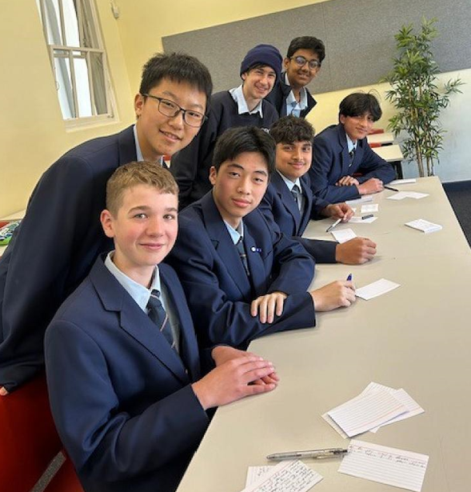
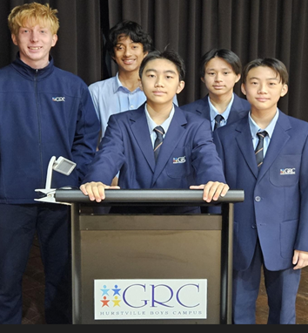
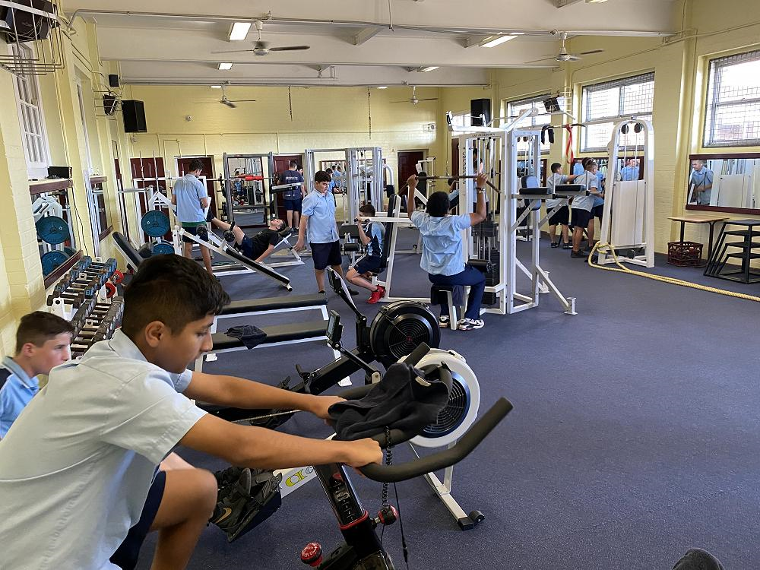
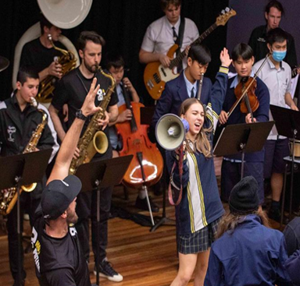
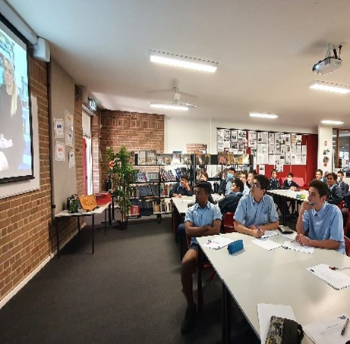
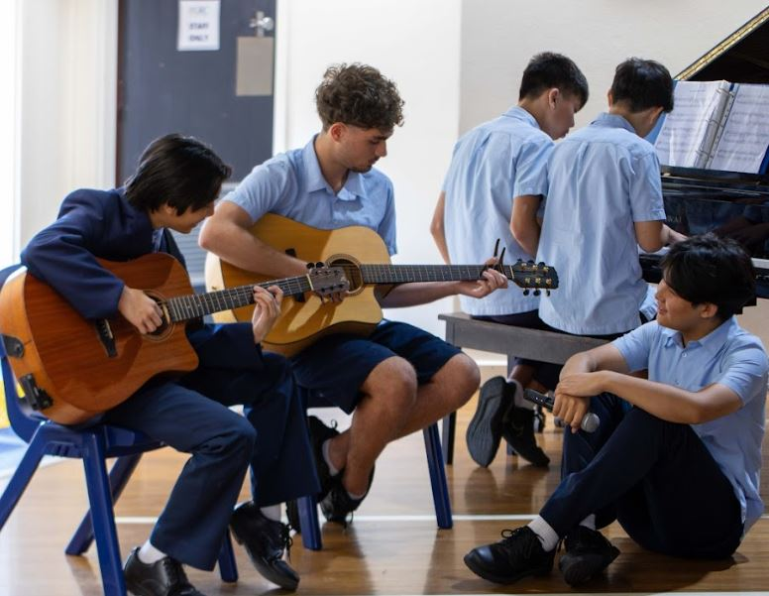
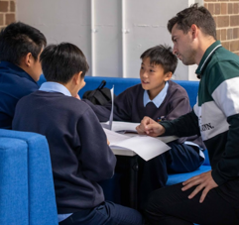
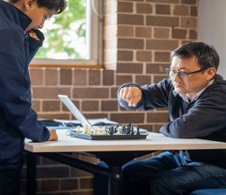
Debating
Leadership Opportunities
Gym
College Programs
TRIBE
Band
Homework Centre
Chess
Co-curricular Experiences
Notes:
Jason CO-CURRICULAR EXPERIENCES
Activities
Chess Club
Band
Creative Writing Workshops
Gym Club
Debating
Public Speaking
TRIBE

Slide 24
Hurstville Campus Deputy Principal
David Davis

Slide 25
Respect
Responsibility
Positive
Behaviour for
Learning (PBL)
Excellence
Notes:
David Core Values
GRC is a Positive Behaviour for Learning (PBL) School
The 3 PBL values are:
Respect,
Responsibility,
Excellence.

Slide 26
Year 7 Transition
Programs
GRIT
Year 7 Adventure Days
Primary School Links (Years 5 & 6)
Head start @ Hurstville (Year 6)
“The Year 7 playground made it much easier to settle in and make new friends.”
Liam, Year 7
Notes:
DD
The aim of the program is to: -
Develop positive peer relationships
Establish positive and respectful relationships with staff
Provide students with greater clarity on processes at our school
Introduce key supports around the school (including the school counsellor, Year Adviser, Student Support Officer and Youth Worker)

Slide 27
Year 10 Transition Programs
Work Experience
Alternative programs
TAFE
Youth Engagement Strategy (YES Program)
Study Skills Program
Visits to Oatley Senior Campus
Subject Selection
Career Expo
Orientation program
Notes:
DD
The aim of the program is to: -
Develop positive peer relationships
Establish positive and respectful relationships with staff
Provide students with greater clarity on processes at our school
Introduce key supports around the school (including the school counsellor, Year Adviser, Student Support Officer and Youth Worker)

Slide 28
Wellbeing Programs
SUPER
PCYC
GRIT
After School Basketball
Gym Club
Breakfast Club
Lunch Club
Lovebites
RAISE Program
Peer Support
Top Blokes
Gardening Club
Individual Mentoring
Study Without Stress
Notes:
Jason Wellbeing Programs
RAISE Program
Headspace Program
Own It
GRIT
PCYC
Individual Mentoring
Breakfast Club
Lovebites
First Nations Games

Slide 29
School Supports
Student Learning Support Officers
School Counsellor
Head Teacher Wellbeing
WHIN
Principal
Year Adviser
Deputy Principal
Class Teacher
Learning and Support Teachers
Student Support Officer
Notes:
DD Student Wellbeing Who can help me at sch
Class Teacher
Learning and Support Teachers
Year Adviser
Student Support Officer
Youth worker
Head Teacher Wellbeing
School Counsellor
WHIN
Deputy Principal
Principal

Slide 30
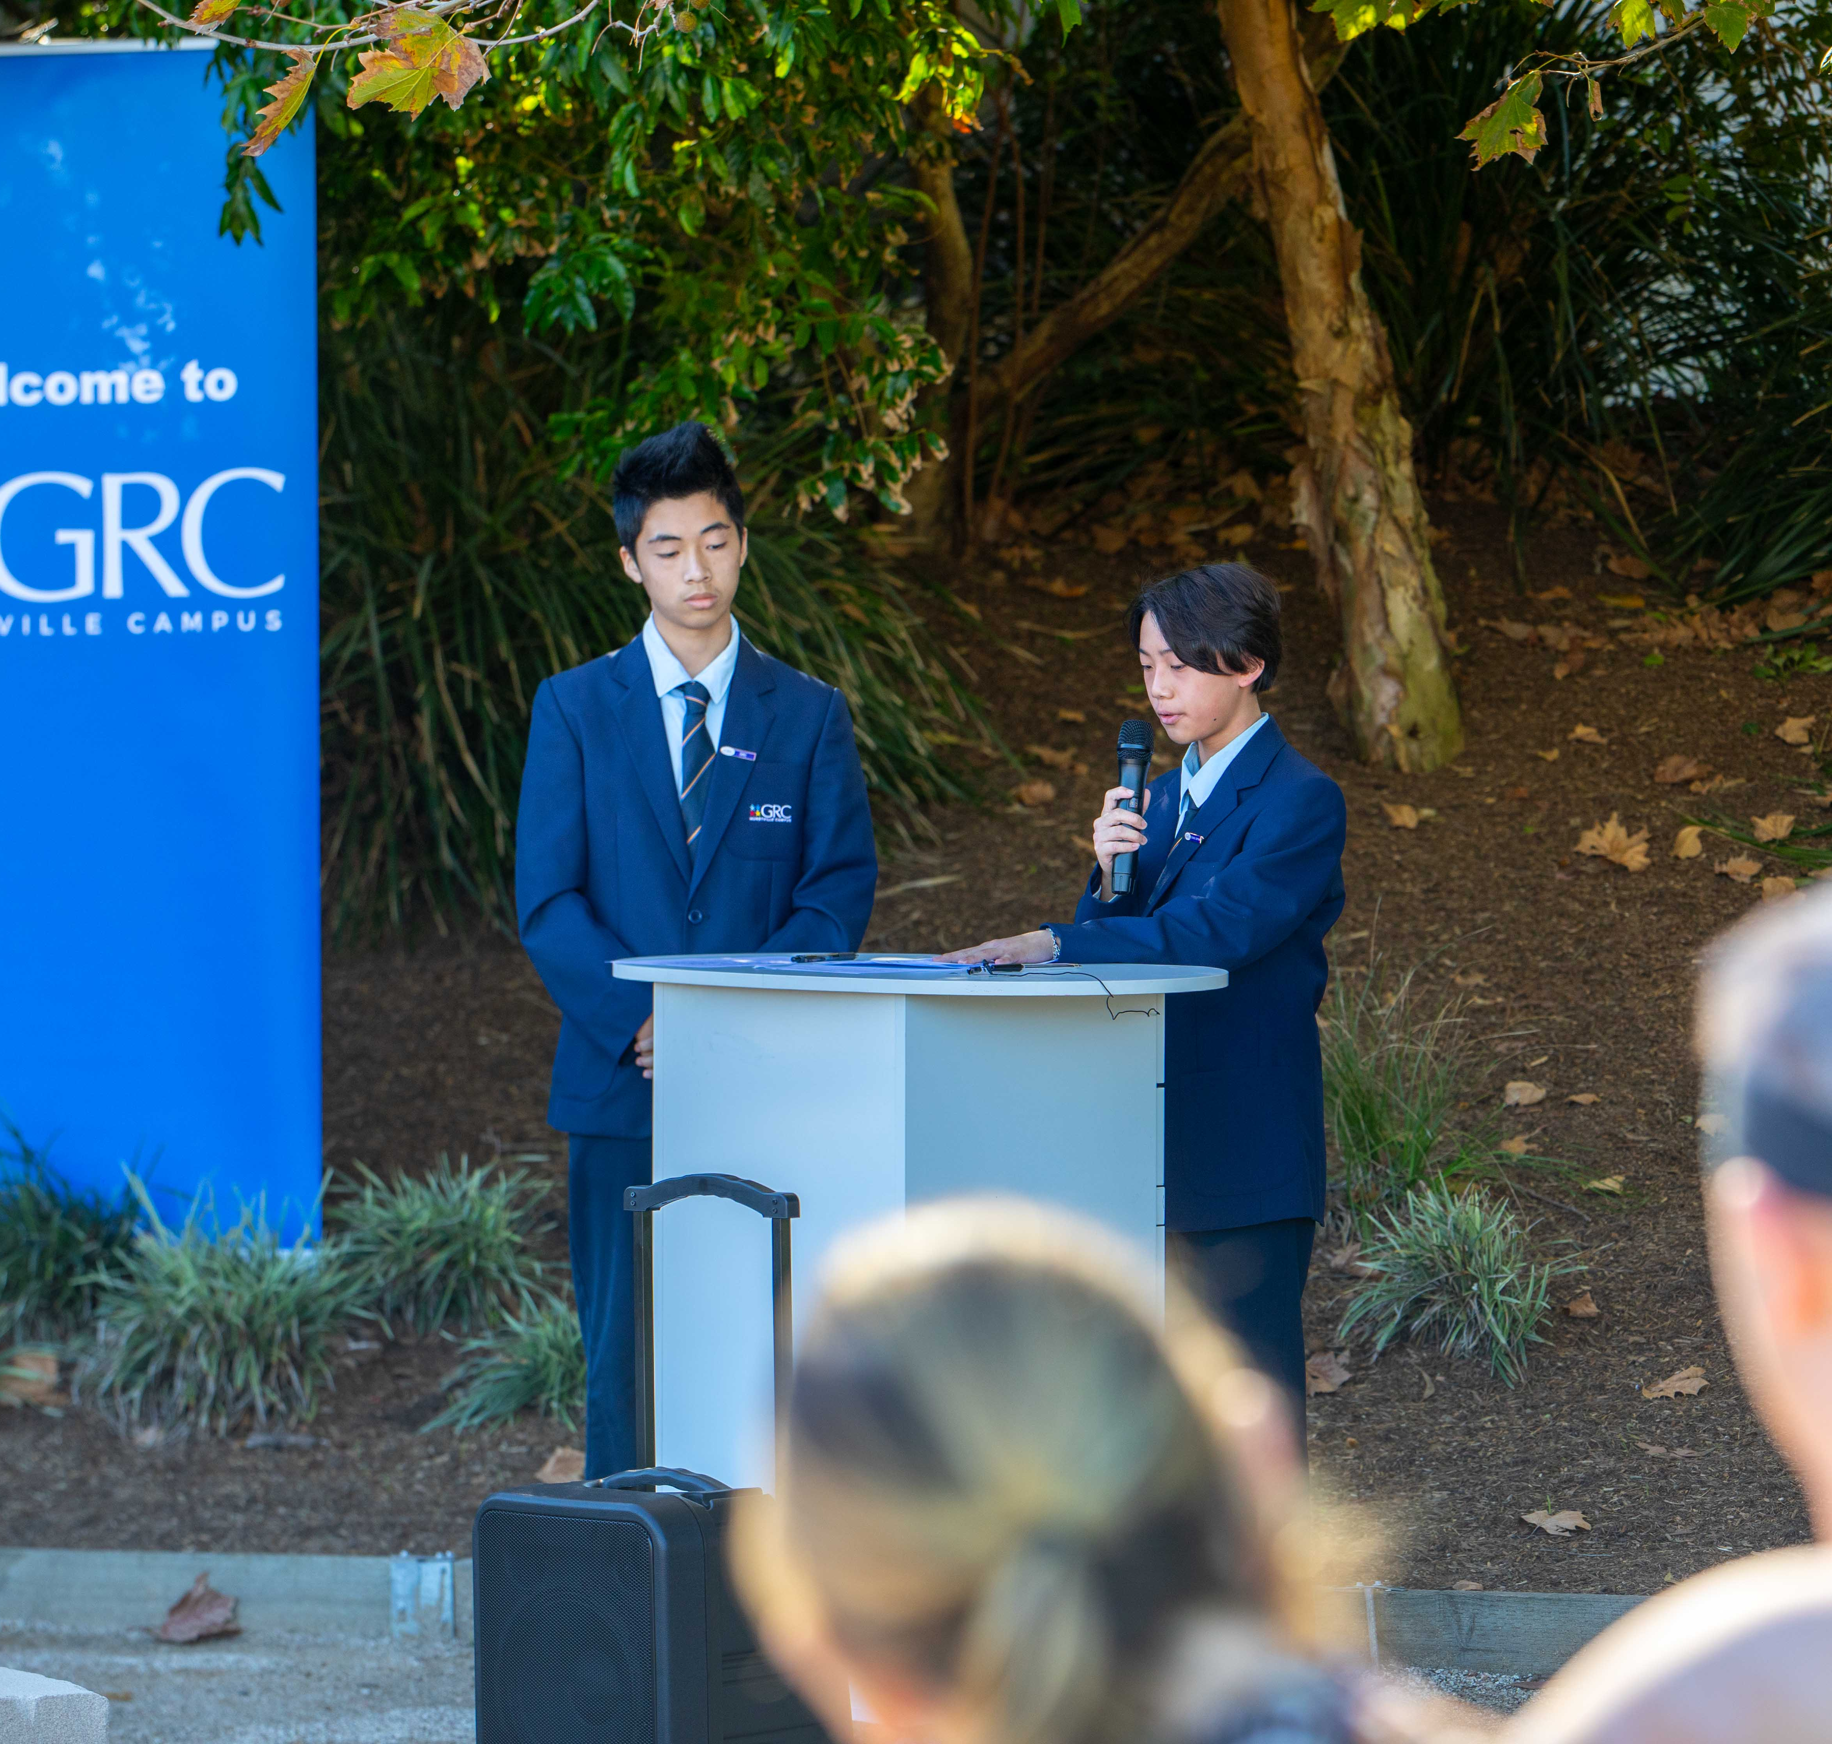
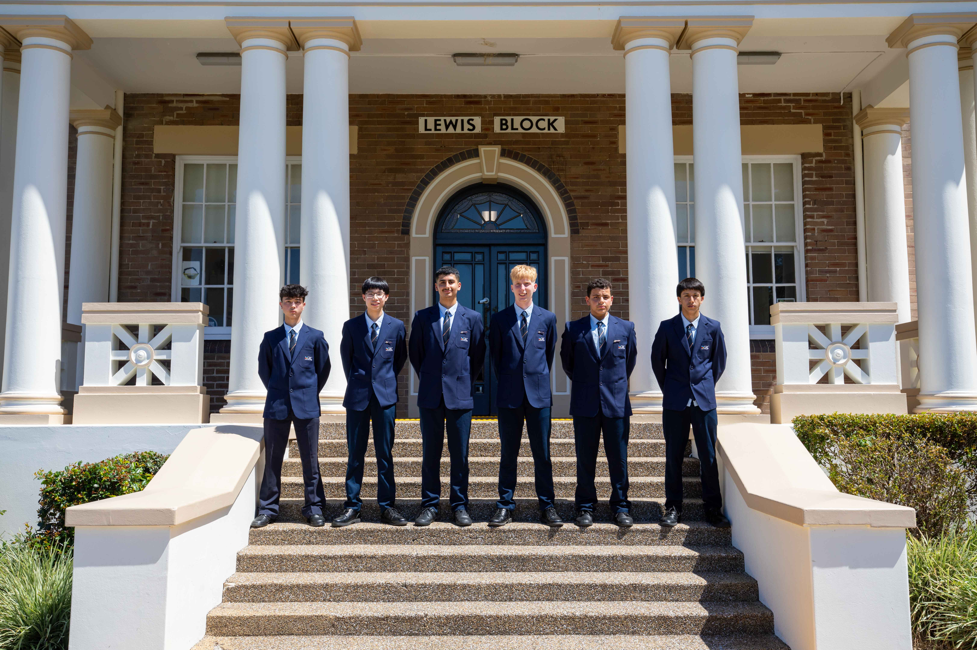
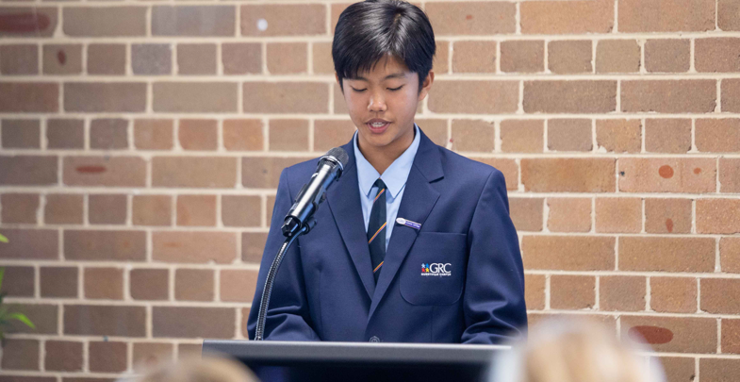
Leadership opportunities
Notes:
DD Leadership opportunities exist for all students from year 7-10.
SRC
Prefecture
House Captains
Peer Support

Slide 31
Open Night
Year 6 into 7 Orientation
Support Unit Orientation
Meet the Teacher BBQ (Year 7)
Parent Teacher Night
ROSE Assemblies (Semester)
Subject Selection Evening
Parent Seminars
P&C Committee
Parent Engagement

Slide 32
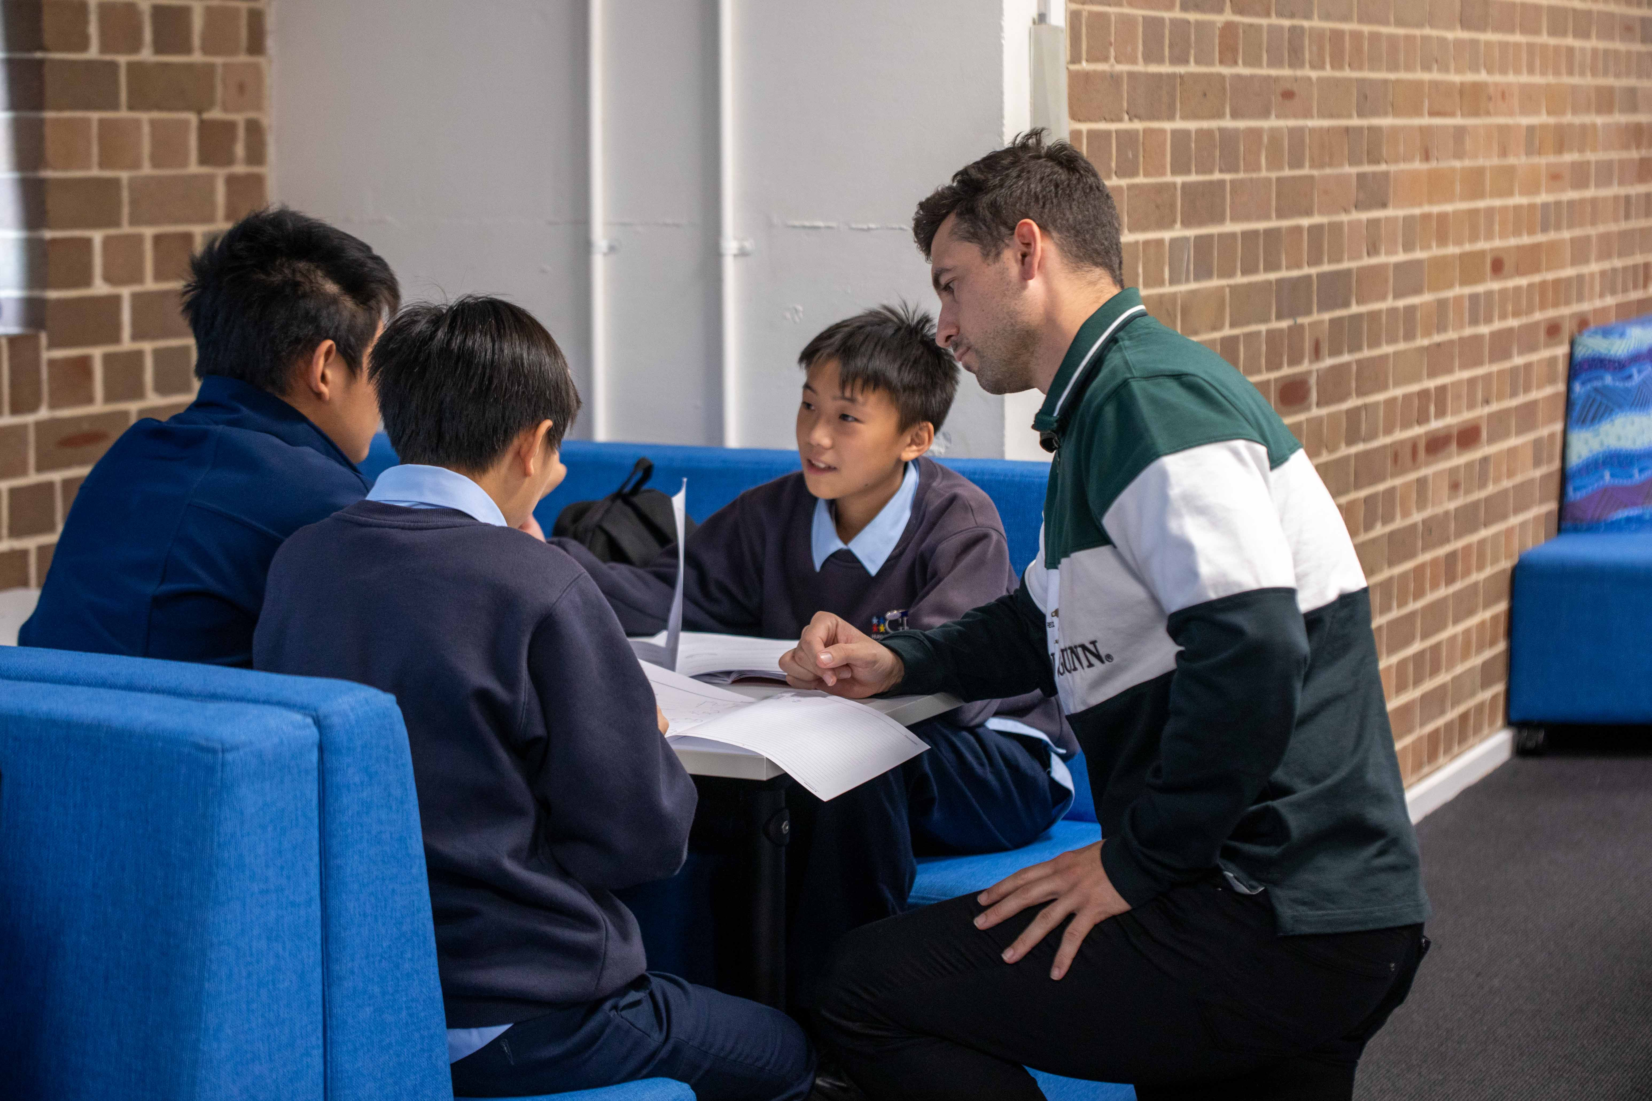
Homework Centre is available for all students to attend and is run by members of the teaching staff to assist students to complete work
Homework Centre

Slide 33
BYOD (Bring Your Own Device)
Notes:
David Technology –BYOD (Bring Your Own Device)
In order to support student learning it is a Campus requirement that all Year 7 students are equipped with their own digital learning device.

Slide 34
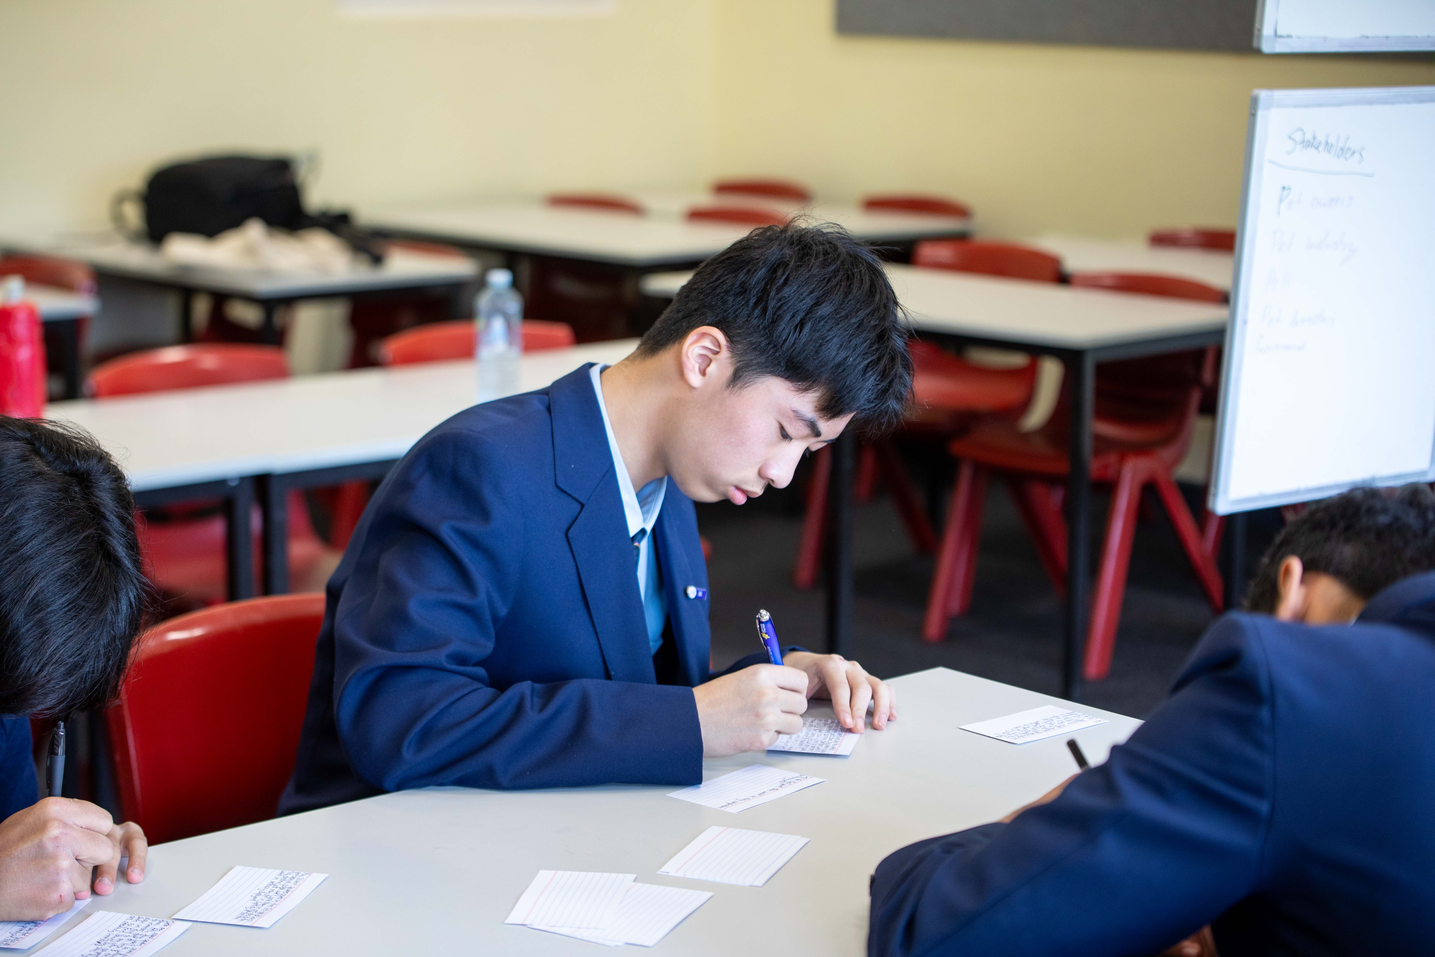
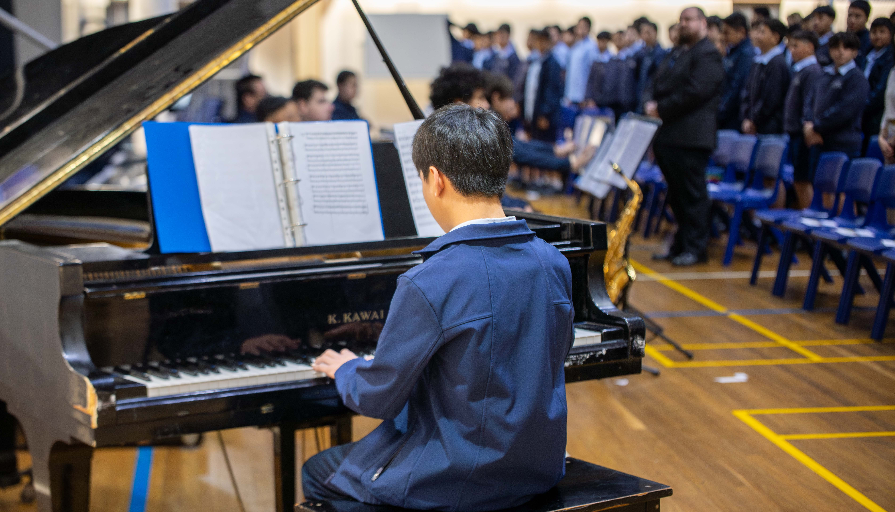
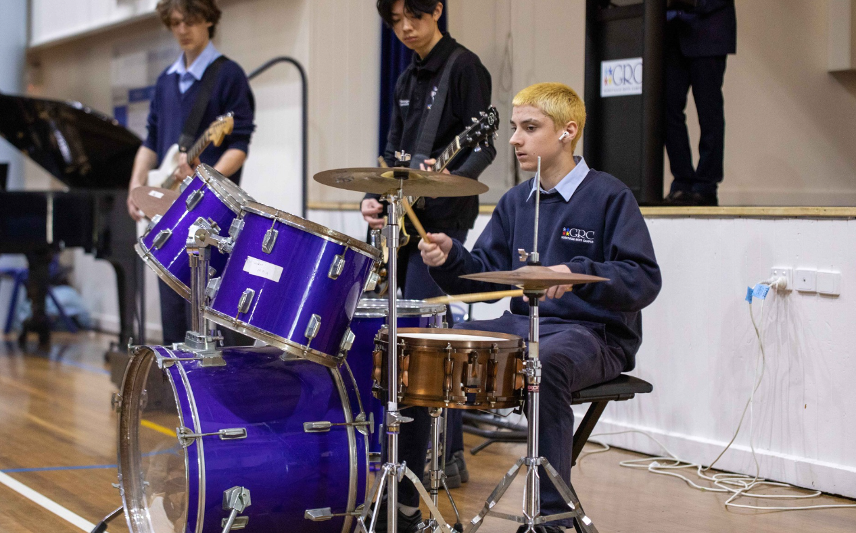
Co-curricular Experiences
Notes:
DD CO-CURRICULAR EXPERIENCES
Activities
Chess Club
Band
Creative Writing Workshops
Gym Club
Debating
Public Speaking
TRIBE

Slide 35
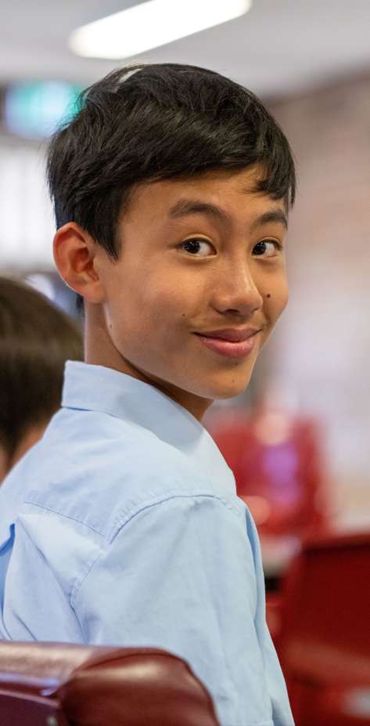
Stay connected
https://www.facebook.com/GRCHurstvilleCampus
https://www.youtube.com/@grchurstvillecampus1842
https://www.instagram.com/grchurstvillecampus/

Slide 36
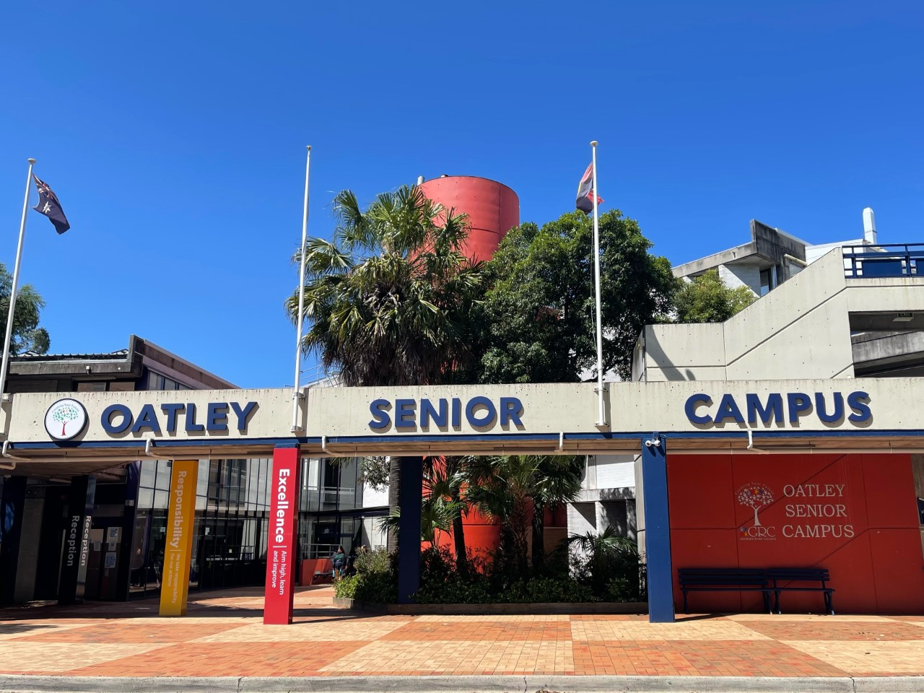
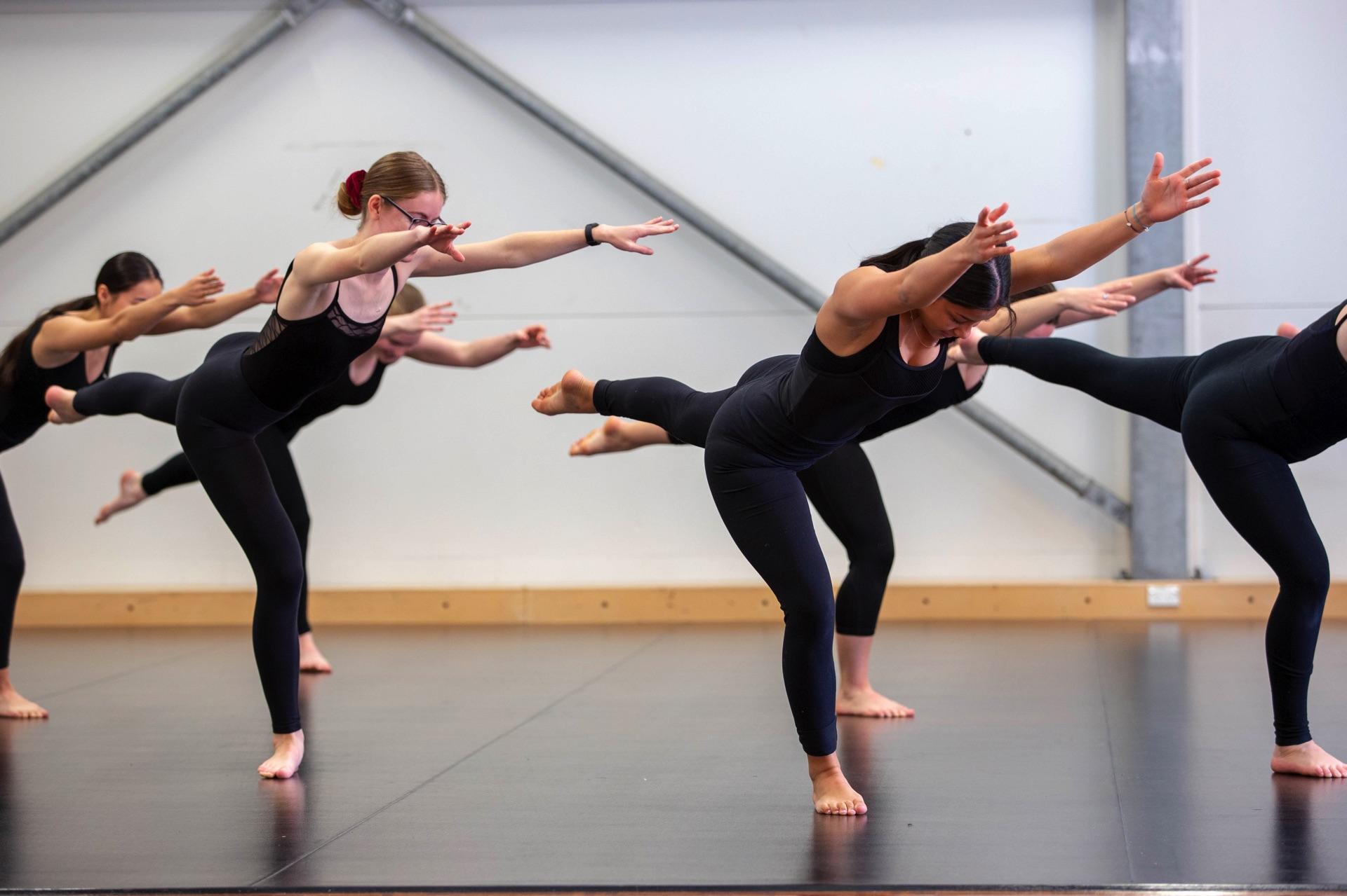
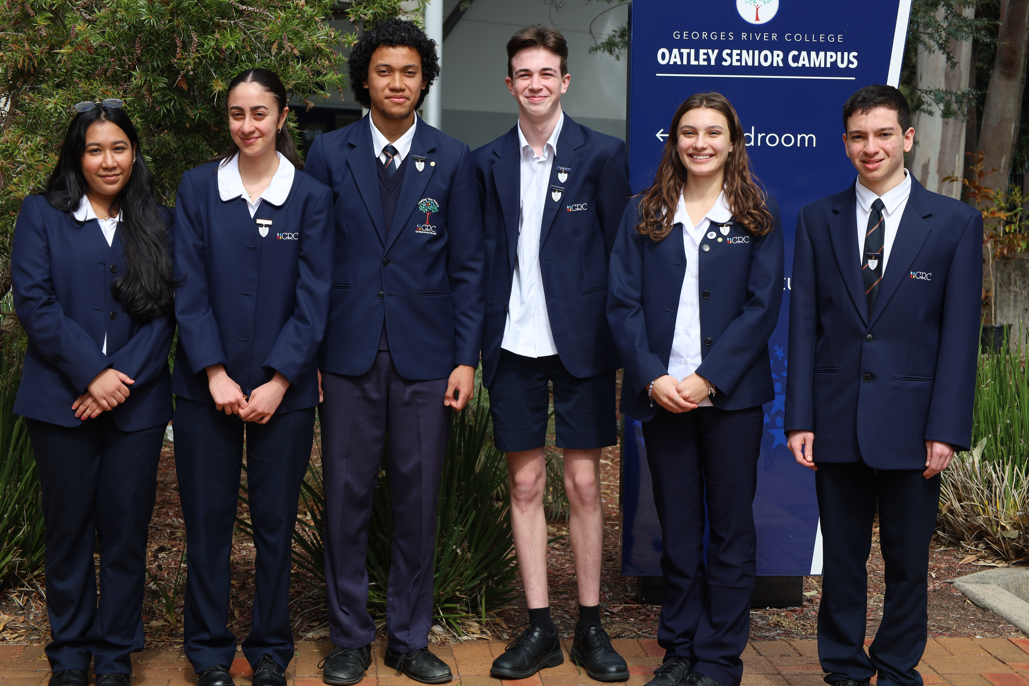
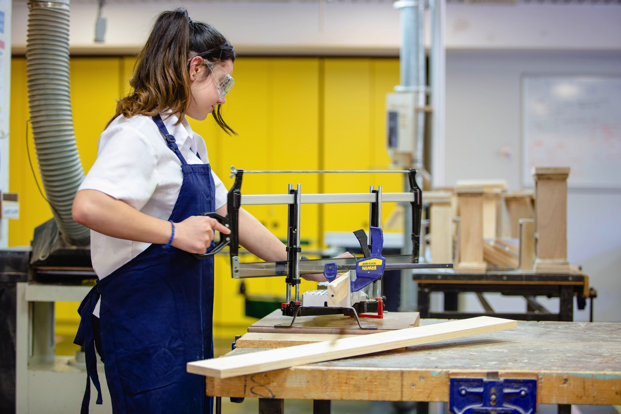
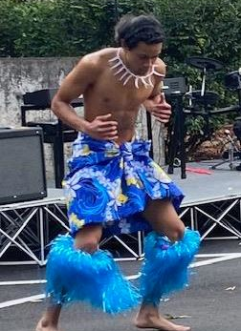
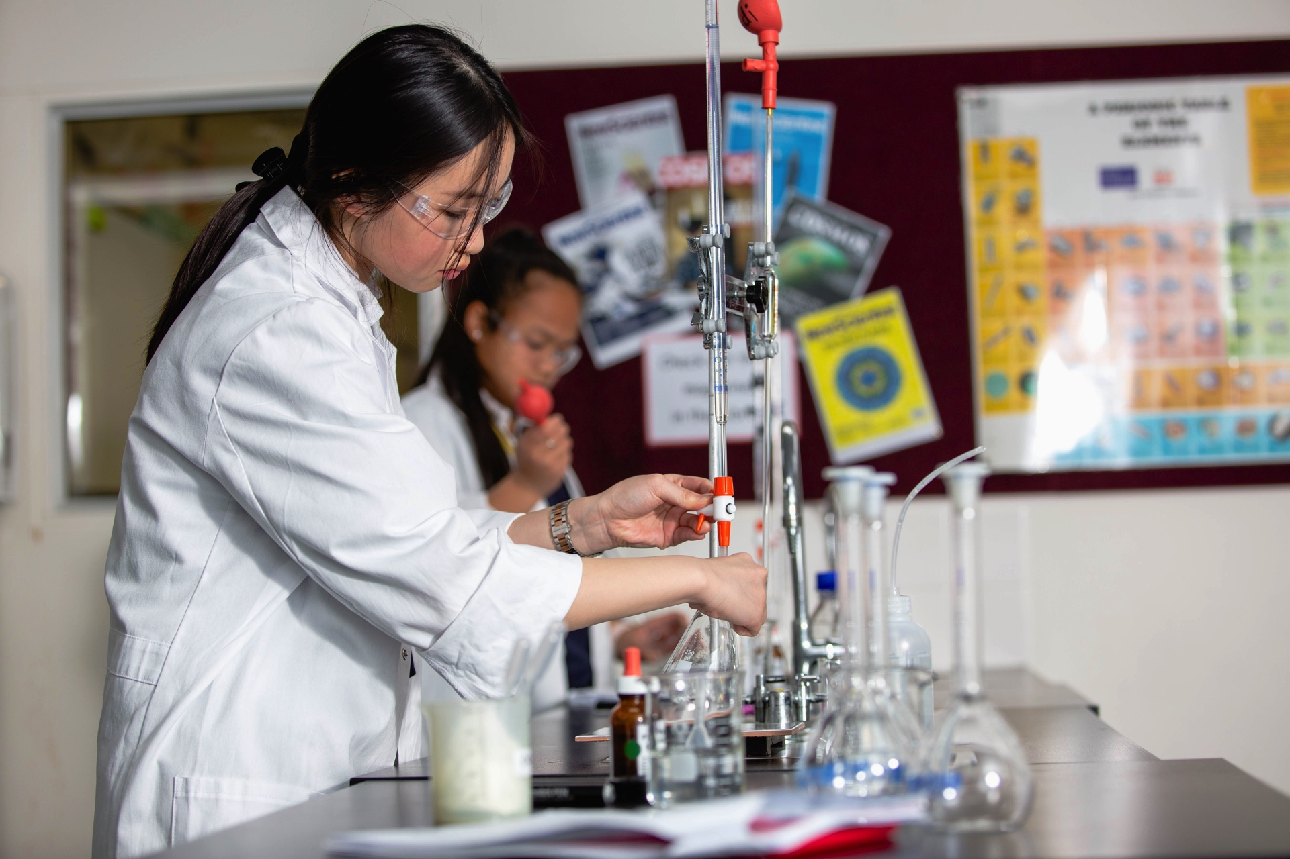

Slide 37
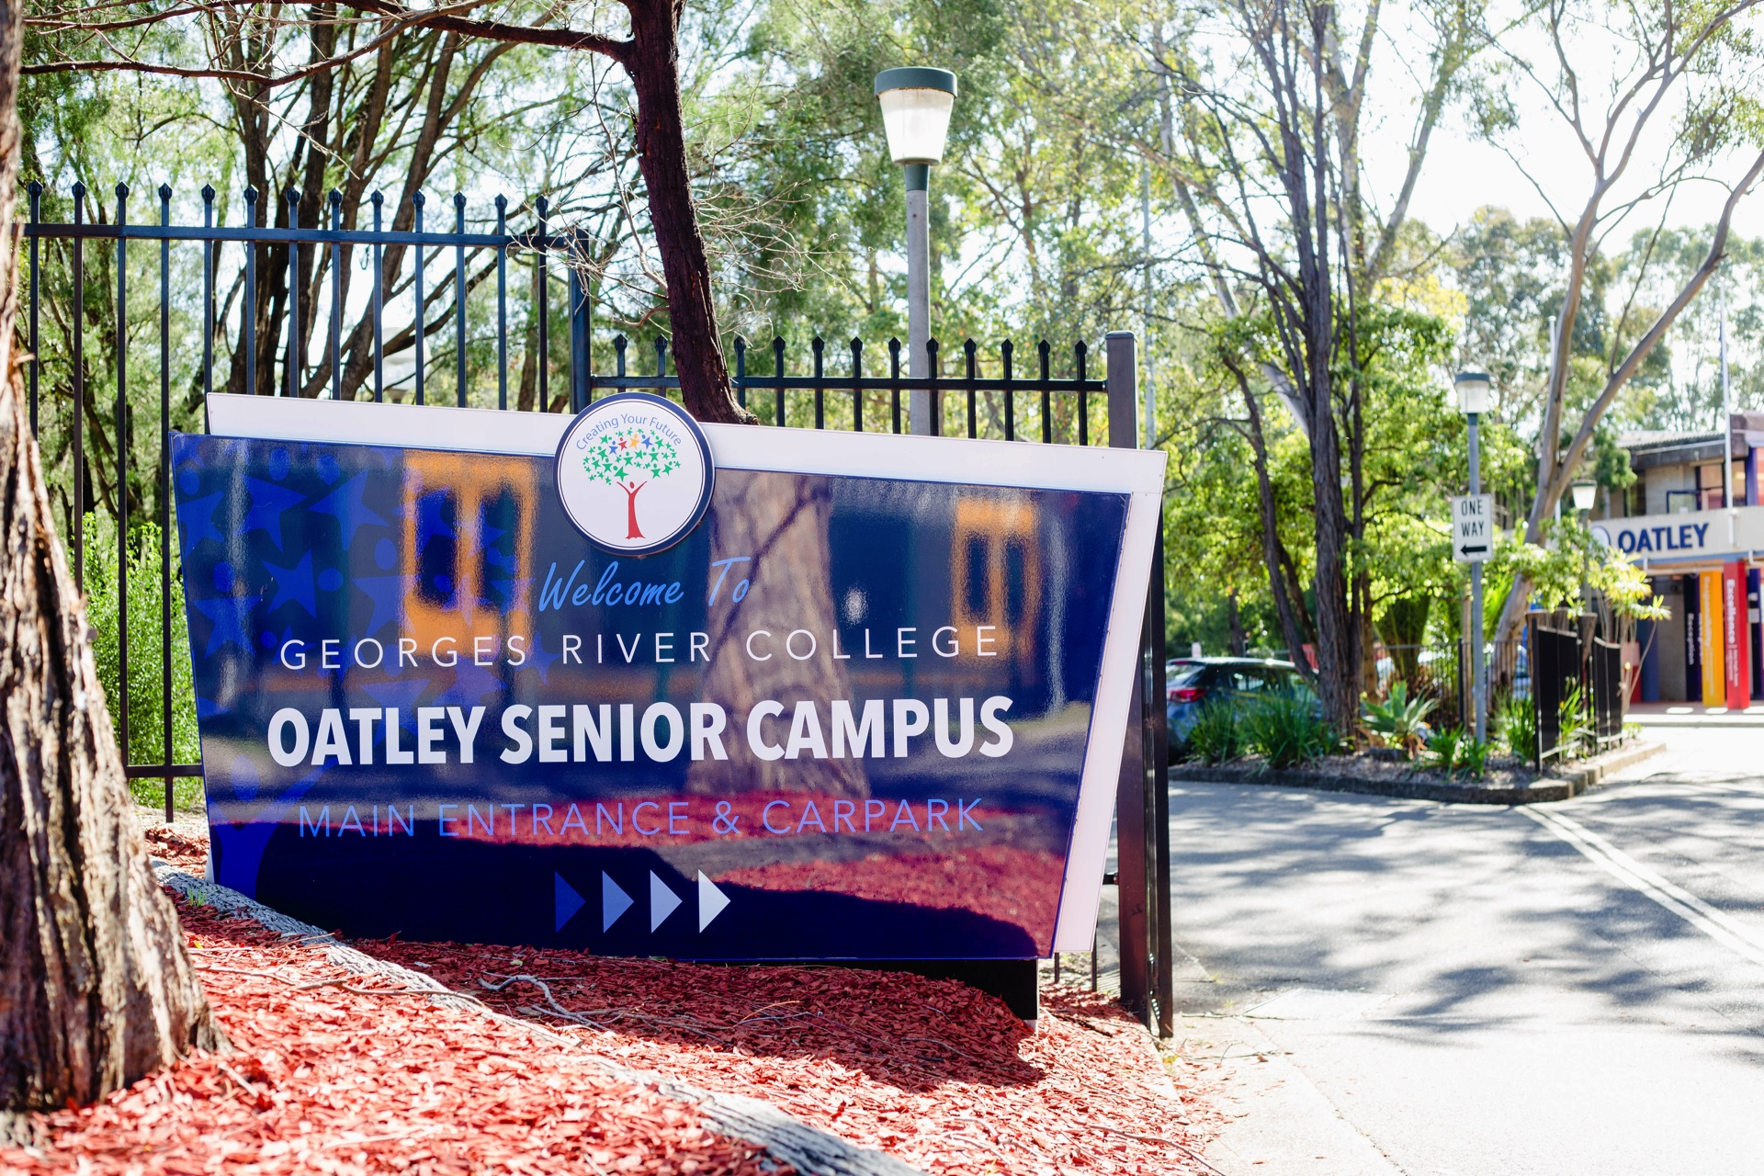
Oatley Senior Campus
Principal
Anna Girginis

Slide 38
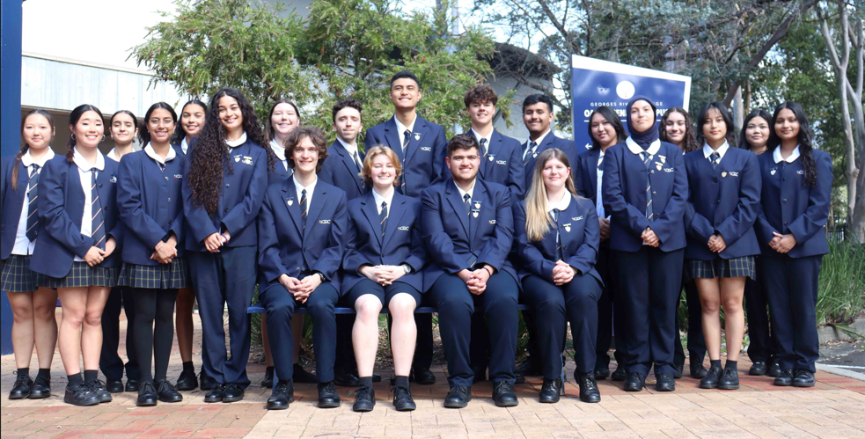
GRC Oatley Senior Campus

Slide 39
A Parent's Perspective
What to look for in a high school?
Leadership
Data
Public v Private
Multi campus v Single campus
Wellbeing Programs
Curriculum Programs
Transition Programs
Opportunities beyond
Notes:
In any one year 75 – 85 subjects
Named by NESA as the school offering the broadest curriculum in the state
One of the largest VET provider of courses in the state
TAFE delivering courses on site

Slide 40
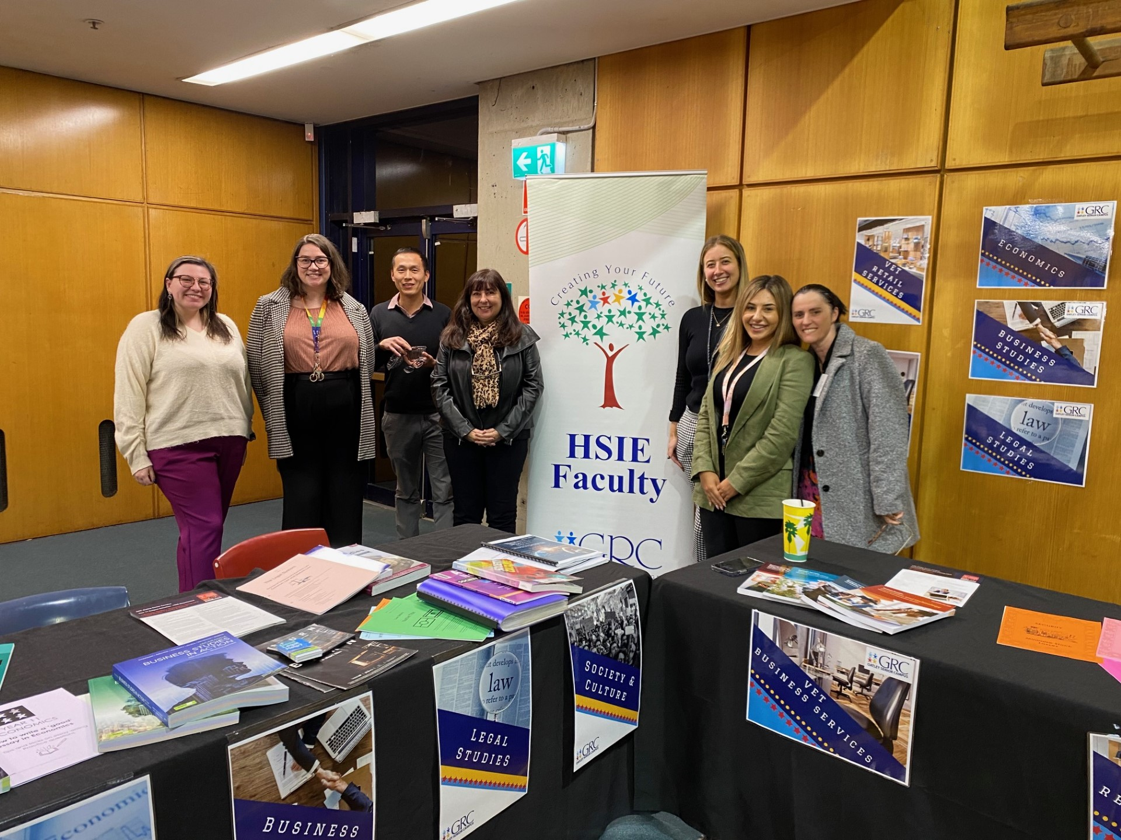
Year 10 into 11 Subject Information Day
Taster Classes
Year 10 into 11 Subject Parent Information Night
Curriculum Expo
Interview with GRC Oatley Campus staff
Sharing of information across campuses
Orientation day
Transition Program

Slide 42
Academic
Vocational
Combination
Employment
Pathways offered @ GRC Oatley

Slide 43
Extensive Curriculum
Types of Courses
Board Developed Courses
Vocational Education and Training(VET)
TAFE Delivered Courses (TVET)
Board Endorsed Courses
TOTAL 75 - 85
Notes:
In any one year 75 – 85 subjects
Named by NESA as the school offering the broadest curriculum in the state
One of the largest VET provider of courses in the state
TAFE delivering courses on site

Slide 46
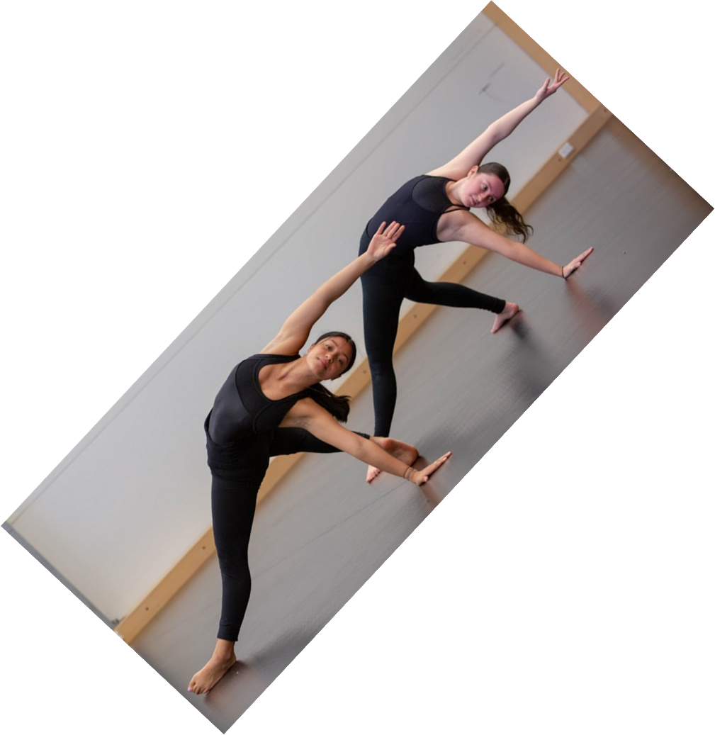
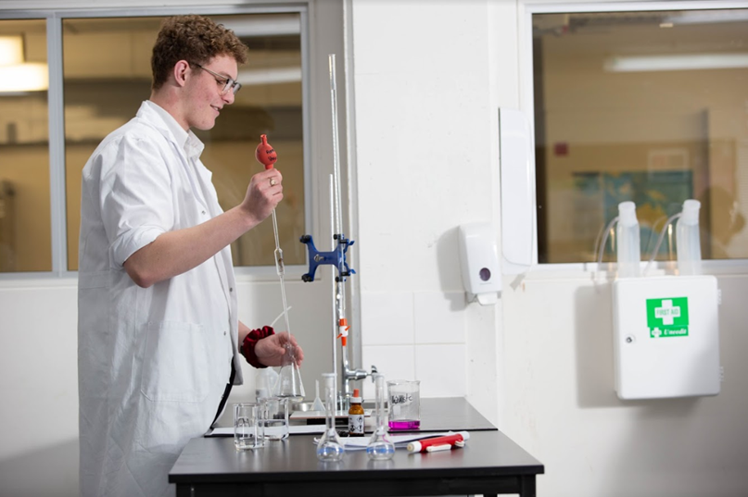
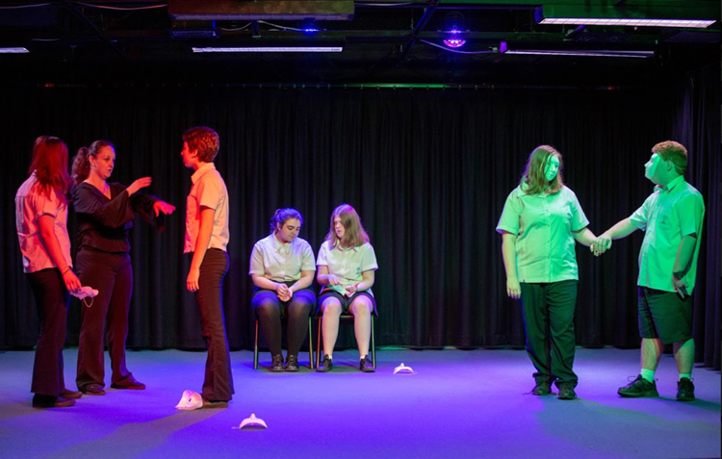
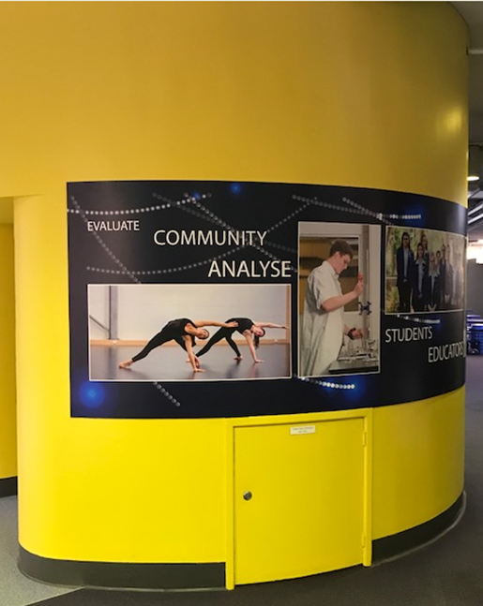
Stage 6 Facilities

Slide 47
Inclusive Education

Slide 49
College Programs
Notes:
Jason Programs for Students across the College
Leadership by the River
College Support Unit Camp
College Stage and Concert Bands
College Musicals

Slide 50
Support Programs
Academic Support
Wellbeing Support
Learning Hub

Slide 51
Oatley Senior Campus
Stay connected
https://www.facebook.com/grcoatleyseniorcampus
https://www.instagram.com/grcoatleysenior/
Newsletter
https://oatleysnr-h.schools.nsw.gov.au/
oatleysnr-h.school@det.nsw.edu.au
02 8657 3700

Slide 52
Make an informed decision, don’t rely on other’s stories
1
Consider all aspects of your child – which schools best meets those needs
2
Don’t base your decision on current friendship groups
3
Remember

Slide 53
Thank you.
Presented by
Kathy Klados | Principal | GRC Hurstville Campus
David Davis | Deputy Principal
Rachelle Pirie | Deputy Principal
Anna Girginis | Principal | GRC Oatley Senior Campus
Email
hurstville-h.school@det.nsw.edu.au
Phone
(02) 9587 3199
Address
Kenwyn St, Hurstville NSW 2220

Slide 54
Questions
Evaluation

